Slide 1
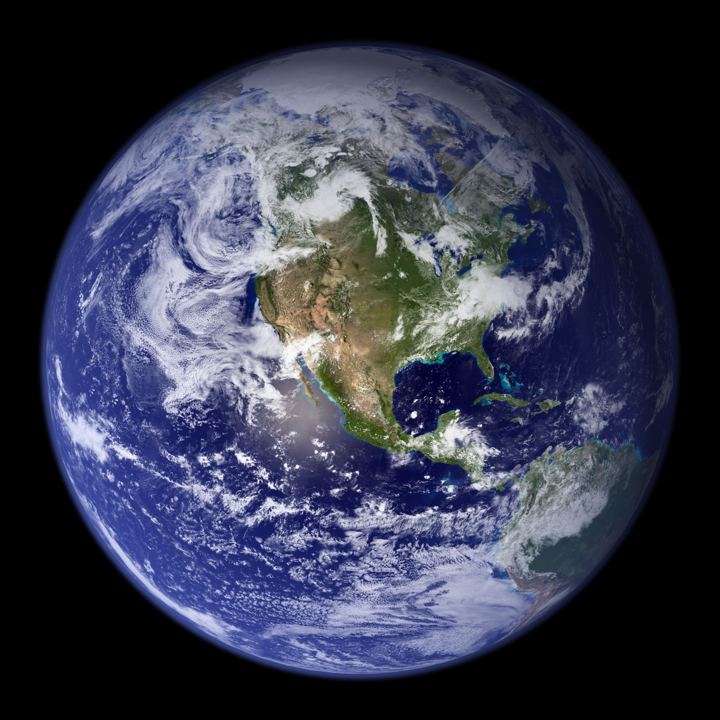

Week 6
Atmospheric Chemistry
Hydrosphere
645284

Slide 2
For Week 6...
Required Videos to Watch:
Stratospheric chemistry
Tropospheric chemistry
The hydrosphere: Where did the oceans come from?
How do the oceans work? Parts 1 and 2
Does the Gulf Stream make Europe temperate?

Slide 3
Questions from last week or videos
Brief weather update
Stratospheric chemistry
Tropospheric chemistry
ManUniCast air-chemistry forecasts
Hydrosphere summary
Kahoot!

Slide 4
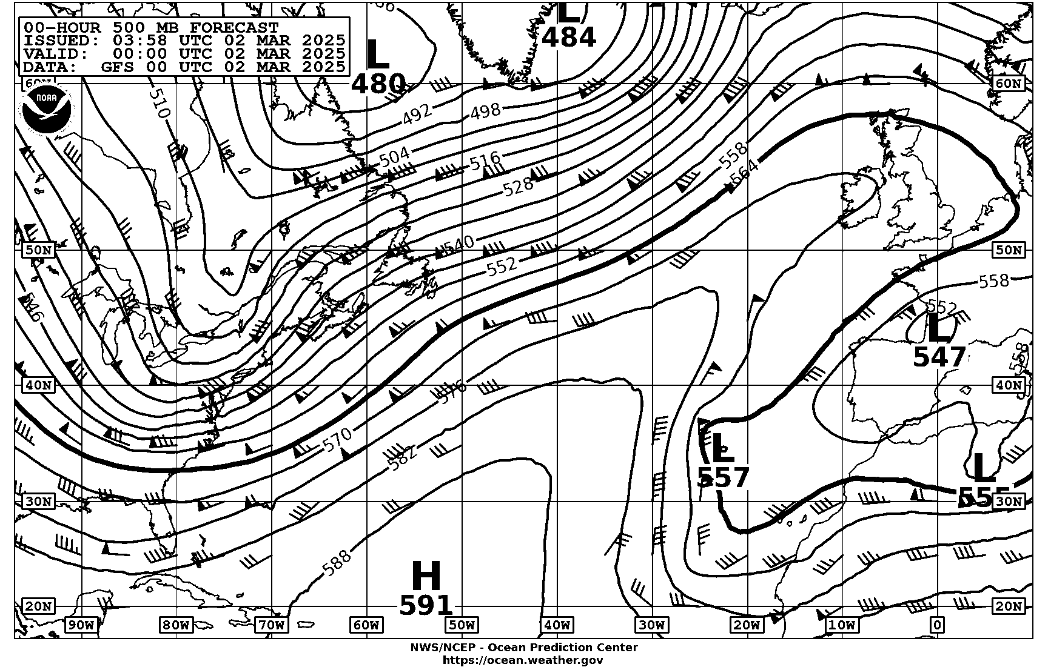

Slide 5
Stratospheric Chemistry
1. ozone loss by chlorine: general decline

Slide 6
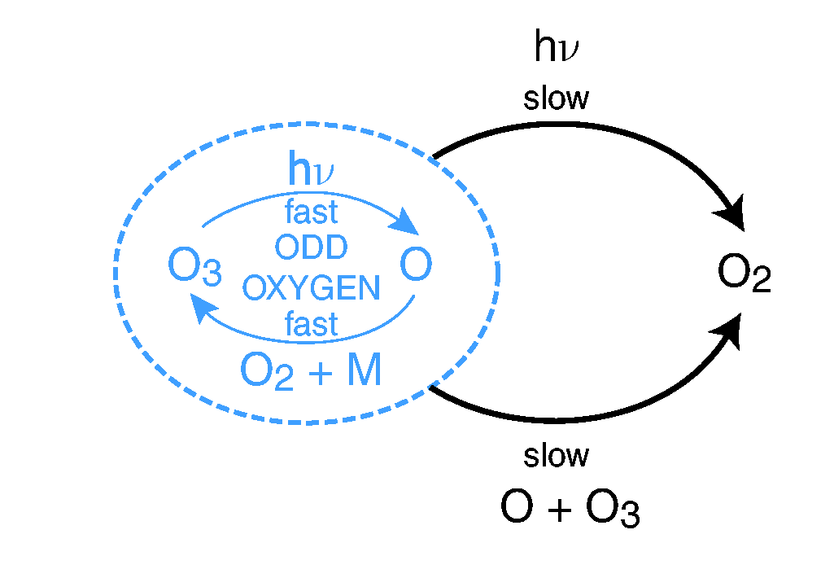

Chapman Cycle: Natural Ozone Processes
[R1] O₂ + hν → 2 O λ < 242 nm
[R2] O + O₂ + M → O₃ + M energy release
[R3] O₃ + hν → O₂ + O λ< 310 nm
[R4] O + O₃ → 2O₂
[R5] O + O + M → O₂ + M
UV
UV
very slow; neglect
[R3]
[R1]
h$υ$ = energy from a photon
h = Planck’s constant
$υ$= frequency (nu, Greek)
M = another molecule to
carry away kinetic energy
[R2]
[R4]
Notes:
The slow reaction (in black) is the break-up and recombination of molecular oxygen (O2).
The fast reaction (in blue) is the break-up and recombination of ozone (O3).
O radical: chemical species with an unpaired electron
R1 initiation
R2, R3 rapid reactions R2 only known way of making O3 in atmos
R4 termination step
R5 so slow you can ignore it
Temperature increases with height through the stratosphere – heat is released as a result of photolysis of O₂ and O₃ by UV radiation – the Chapman cycle.

Slide 7
Chapman Cycle: Natural Ozone Processes
[R1] O₂ + hν → 2 O λ < 242 nm
[R2] O + O₂ + M → O₃ + M
[R3] O₃ + hν → O₂ + O λ< 310 nm
[R4] O + O₃ → 2O₂
[R5] O + O + M → O₂ + M
creates/destroys
odd oxygen
creates/destroys
ozone
very slow; neglect
[R3]
[R1]
creates/destroys
odd oxygen
h$υ$ = energy from a photon
h = Planck’s constant
$υ$= frequency (nu, Greek)
M = another molecule to
carry away kinetic energy
creates/destroys
ozone
[R2]
[R4]
Notes:
The slow reaction (in black) is the break-up and recombination of molecular oxygen (O2).
The fast reaction (in blue) is the break-up and recombination of ozone (O3).
O radical: chemical species with an unpaired electron
R1 initiation
R2, R3 rapid reactions R2 only known way of making O3 in atmos
R4 termination step
R5 so slow you can ignore it
Temperature increases with height through the stratosphere – heat is released as a result of photolysis of O₂ and O₃ by UV radiation – the Chapman cycle.

Slide 8
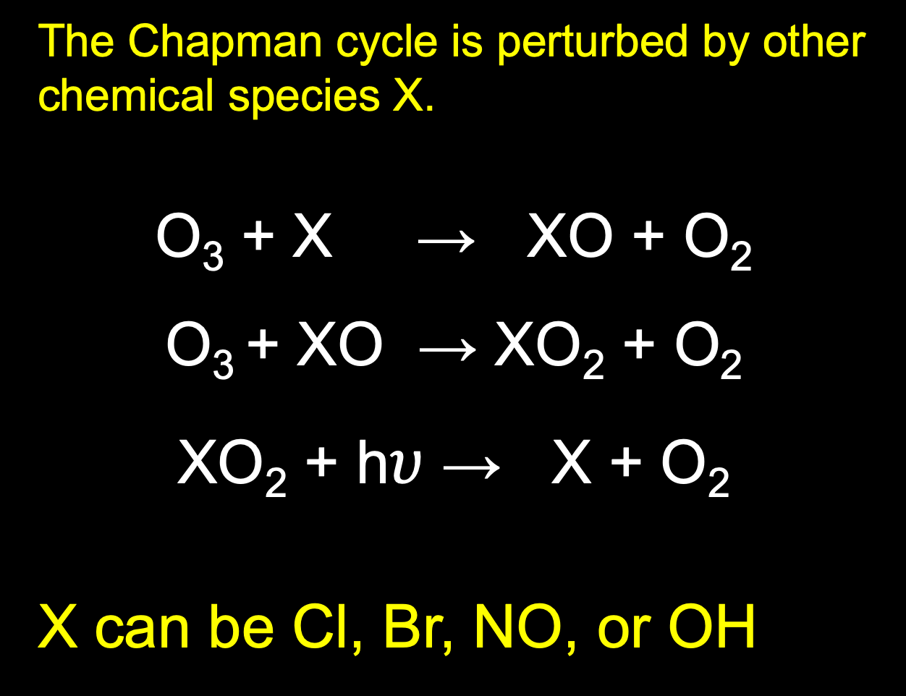
The Chapman cycle is perturbed by other chemical species X.
O₃ + X → XO + O₂
O₃ + XO → XO₂ + O₂
XO₂ + h$υ$ → X + O₂
X can be Cl, Br, NO, or OH
Notes:
This perturbation can be either natural (e.g., chlorine from volcanic eruptions) or anthropogenic (e.g., chlorine from the breakdown or photolysis of chlorofluorocarbons).
This is a catalytic cycle - ozone is destroyed and the reactant is recycled.
OH is made from water vapour. Water vapour in the stratosphere is formed from the destruction of methane in the stratosphere
NO comes from N₂O, part of the nitrogen cycle
Cl and Br arise from some naturally occurring organic halogens but have also increased substantially from long-lived CFCs

Slide 9
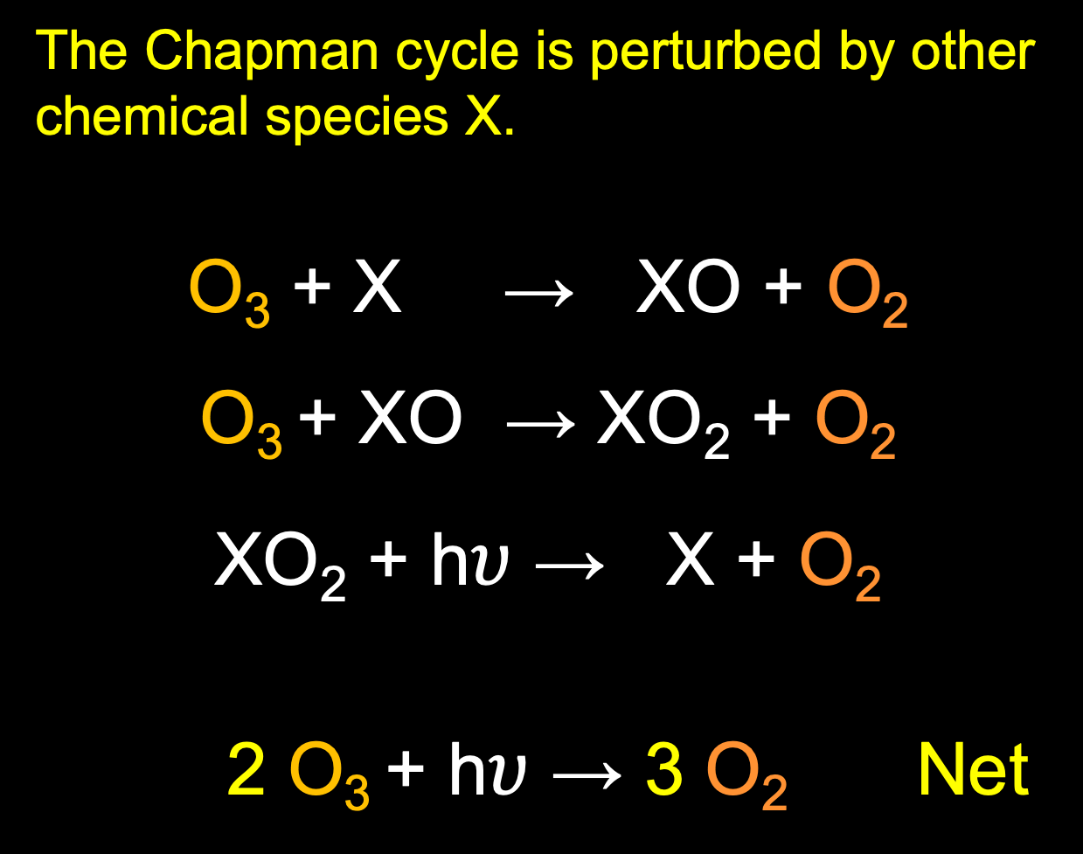
The Chapman cycle is perturbed by other chemical species X.
O₃ + X → XO + O₂
O₃ + XO → XO₂ + O₂
XO₂ + h$υ$ → X + O₂
2 O₃ + h$υ$ → 3 O₂ Net
Notes:
This perturbation can be either natural (e.g., chlorine from volcanic eruptions) or anthropogenic (e.g., chlorine from the breakdown or photolysis of chlorofluorocarbons).
This is a catalytic cycle - ozone is destroyed and the reactant is recycled.
OH is made from water vapour. Water vapour in the stratosphere is formed from the destruction of methane in the stratosphere
NO comes from N₂O, part of the nitrogen cycle
Cl and Br arise from some naturally occurring organic halogens but have also increased substantially from long-lived CFCs

Slide 10
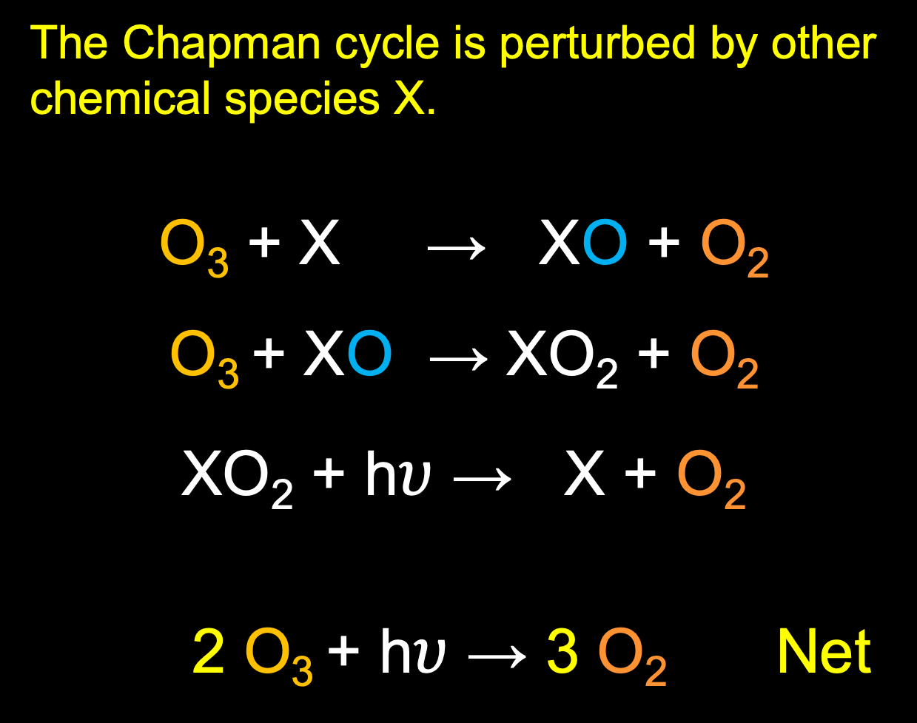
The Chapman cycle is perturbed by other chemical species X.
O₃ + X → XO + O₂
O₃ + XO → XO₂ + O₂
XO₂ + h$υ$ → X + O₂
2 O₃ + h$υ$ → 3 O₂ Net
X steals O, destroying two ozones
Notes:
This is a catalytic cycle - ozone is destroyed and the reactant is recycled.
OH is made from water vapour. Water vapour in the stratosphere is formed from the destruction of methane in the stratosphere
NO comes from N₂O, part of the nitrogen cycle
Cl and Br arise from some naturally occurring organic halogens but have also increased substantially from long-lived CFCs

Slide 11
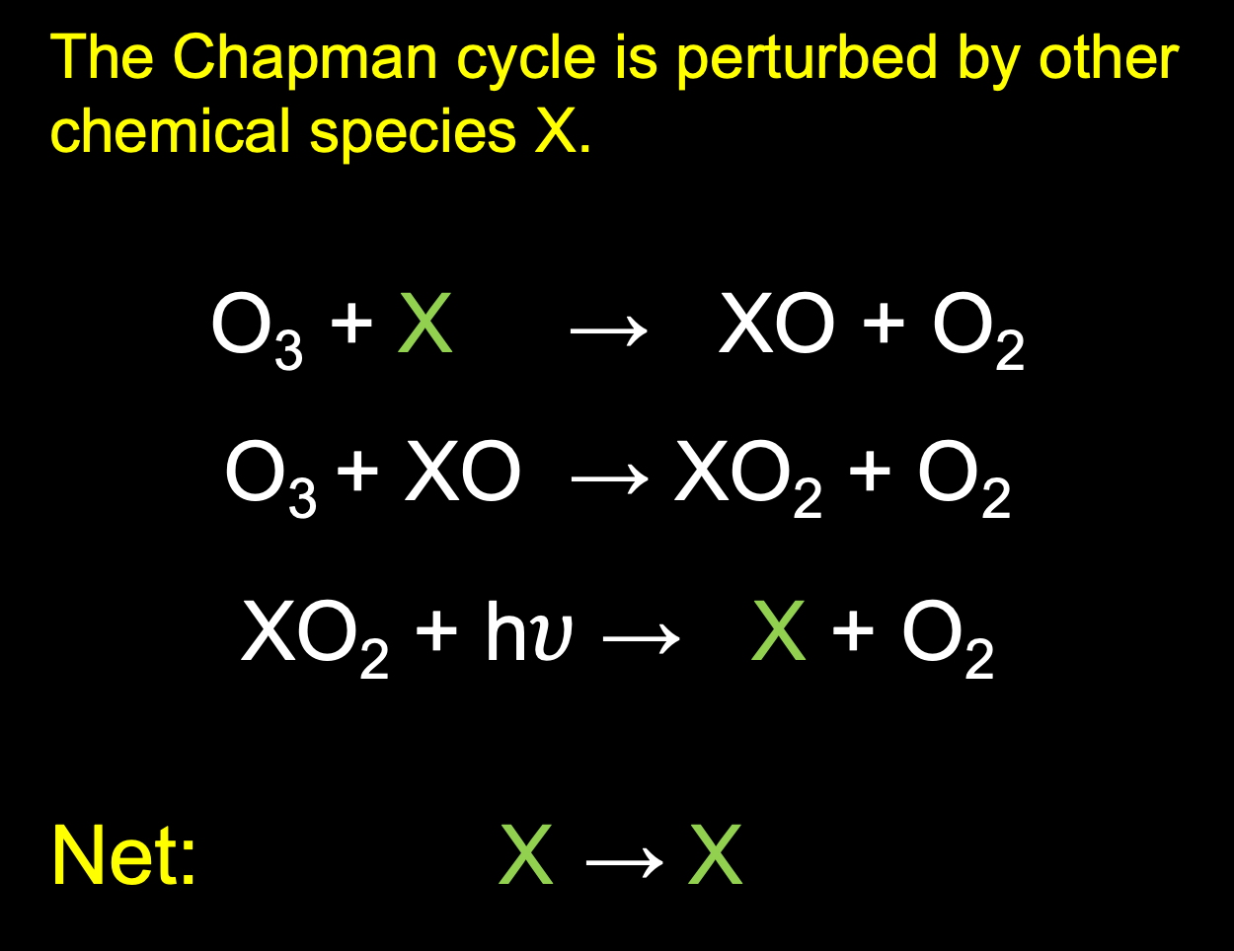
The Chapman cycle is perturbed by other chemical species X.
O₃ + X → XO + O₂
O₃ + XO → XO₂ + O₂
XO₂ + h$υ$ → X + O₂
Net: X → X
X is not consumed in reaction
Notes:
This is a catalytic cycle - ozone is destroyed and the reactant is recycled.
OH is made from water vapour. Water vapour in the stratosphere is formed from the destruction of methane in the stratosphere
NO comes from N₂O, part of the nitrogen cycle
Cl and Br arise from some naturally occurring organic halogens but have also increased substantially from long-lived CFCs

Slide 12

catalytic cycle
catalysis
O₃ + X → XO + O₂
O₃ + XO → XO₂ + O₂
XO₂ + h$υ$ → X + O₂
Net: X → X
X is not consumed in reaction
Notes:
Cata- ”complete” plus lysis (“loosening”)
This is a catalytic cycle - ozone is destroyed and the reactant is recycled.
OH is made from water vapour. Water vapour in the stratosphere is formed from the destruction of methane in the stratosphere
NO comes from N₂O, part of the nitrogen cycle
Cl and Br arise from some naturally occurring organic halogens but have also increased substantially from long-lived CFCs

Slide 13
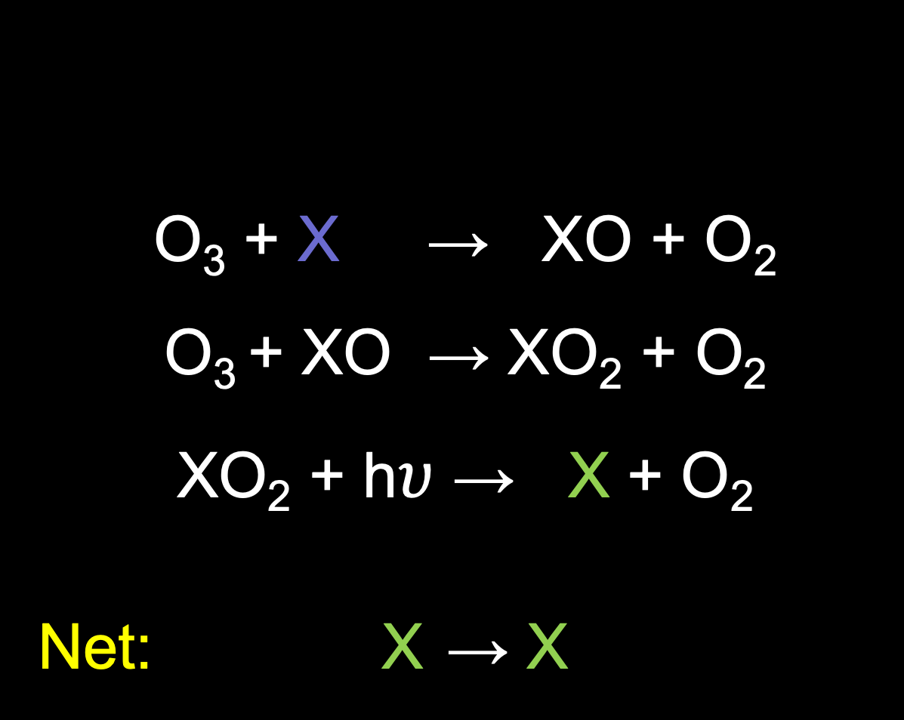
catalytic cycle
catalysis
O₃ + X → XO + O₂
O₃ + XO → XO₂ + O₂
XO₂ + h$υ$ → X + O₂
Net: X → X
Where did the atomic
chlorine come from?
X is not consumed in reaction
Notes:
This is a catalytic cycle - ozone is destroyed and the reactant is recycled.
OH is made from water vapour. Water vapour in the stratosphere is formed from the destruction of methane in the stratosphere
NO comes from N₂O, part of the nitrogen cycle
Cl and Br arise from some naturally occurring organic halogens but have also increased substantially from long-lived CFCs

Slide 14
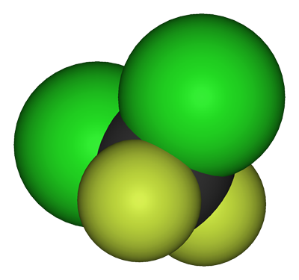
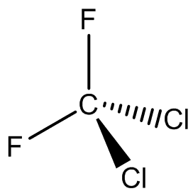
Where did the atomic chlorine come from? CFC-12
chlorofluorocarbon
F
F
C
Cl
Cl
dichlorodifluoromethane
Notes:
This is a catalytic cycle - ozone is destroyed and the reactant is recycled.
OH is made from water vapour. Water vapour in the stratosphere is formed from the destruction of methane in the stratosphere
NO comes from N₂O, part of the nitrogen cycle
Cl and Br arise from some naturally occurring organic halogens but have also increased substantially from long-lived CFCs

Slide 15
Stratospheric Chemistry
1. ozone loss by chlorine: general decline
2. ozone hole: focused (space and time)
and huge ozone loss

Slide 16
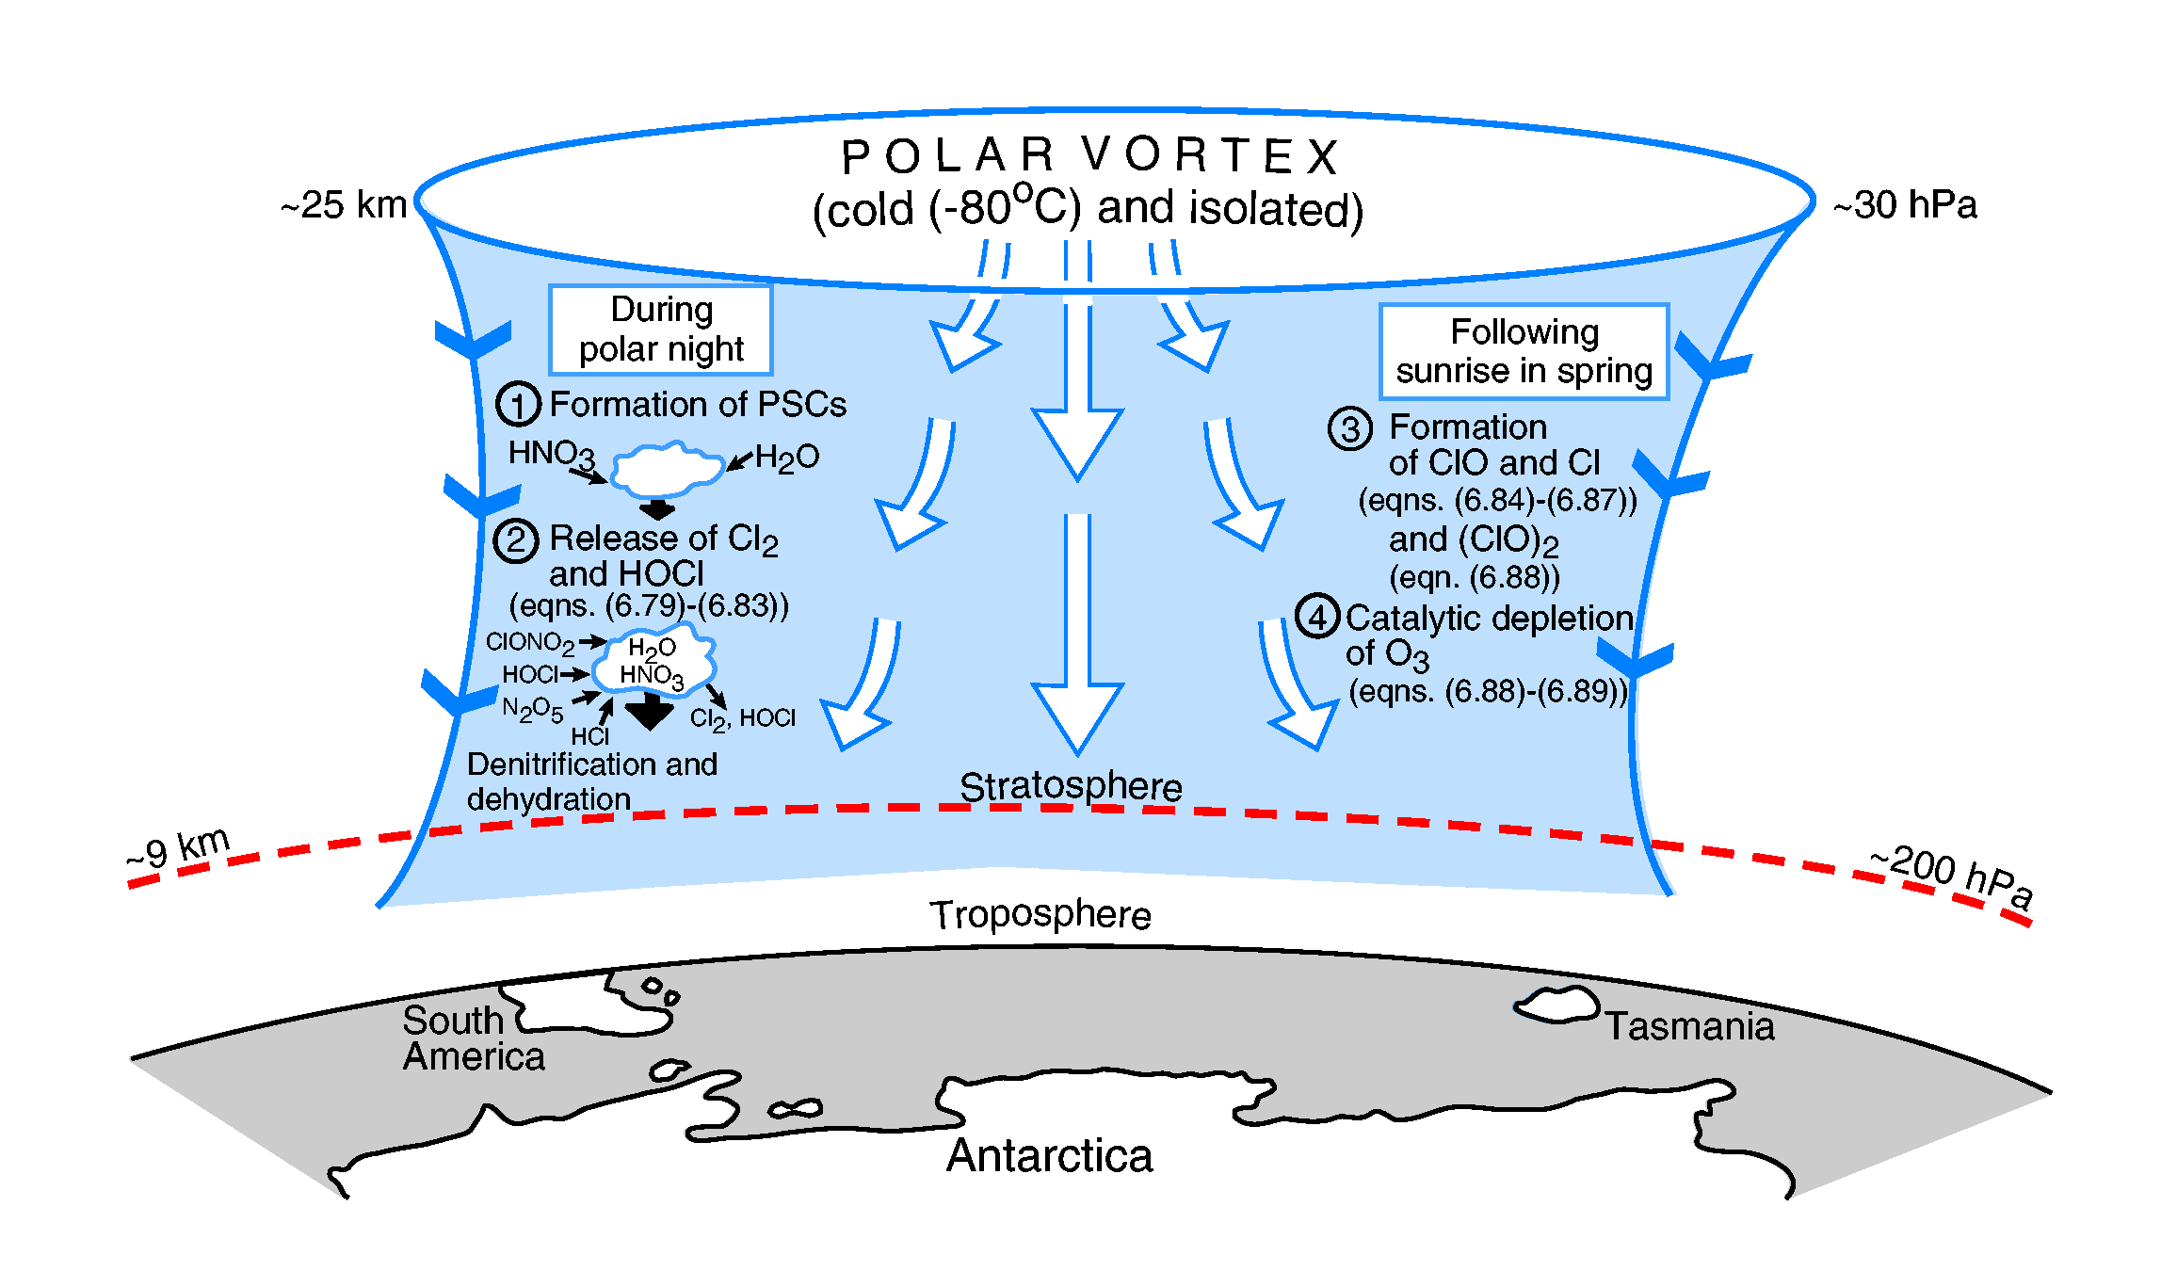
Think of the polar vortex as an extension of the jet stream in the stratosphere
O₃ hole time line, 1
Notes:
1. Chlorine and nitrogen compounds in the stratosphere react to form stable compounds such as HCl and ClONO₂.
2. These are transported towards the poles
3. During the cold polar winter, a strong descent of air occurs and the core of the vortex becomes separated from the air farther equatorward.
4. The vortex core becomes cold enough for polar stratospheric clouds (nitric acid and water ice crystals) to form. (1) in the figure above
5. These clouds provide surfaces for reactions that release the Cl into more active forms such as Cl₂ and HOCl. (2)
6. These species build up over the polar winter in the dark. As clouds of nitric acid and water ice form, the stratosphere becomes denitrified and dehydrated.
Following sunrise in spring:
1. These compounds are photolysed to form Cl, ClO and other highly reactive compounds. (3)
2. The Cl compounds act as the X in the modification of the Chapman cycle and can catalytically destroy O₃. (4)
3. The Cl compounds are regenerated and so catastrophic loss of ozone can occur.
4. Since there is no ozone in the polar vortex then there is no absorption of UV and so the stratosphere cannot readily warm. This maintains the vortex and prevents ozone rich air from lower latitudes to mix into the core and extends the lifetime of the vortex and the period of low ozone.

Slide 17
Tropospheric Chemistry

Slide 18
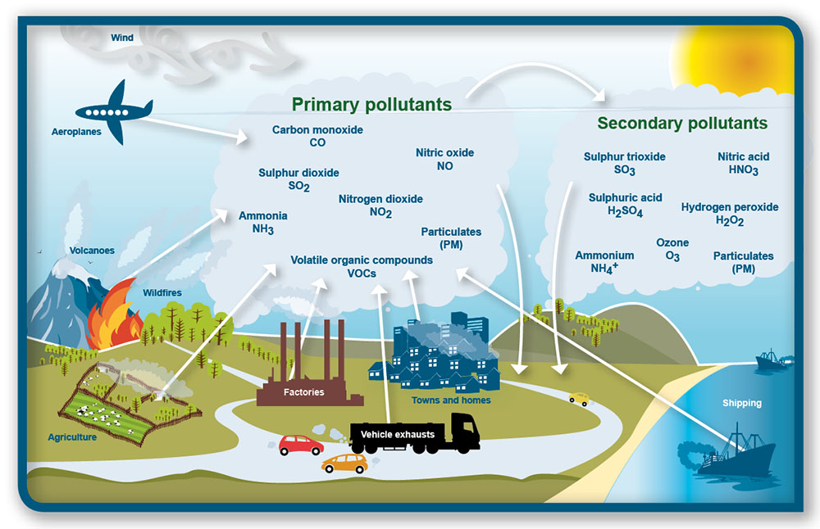

Slide 21
Ozone in the stratosphere: GOOD
Ozone in the troposphere: BAD

Slide 22
OH is an important oxidant in the atmosphere.
OH has a short lifetime in the atmosphere (1 s) and nearly constant concentrations (reformed as quickly as it is destroyed).
Presence of OH in troposphere helps convert NO₂ (primary pollutant) to HNO₃ (secondary pollutant), and remove it from the gas phase.
Other pollutants (e.g., methane, carbon monoxide, VOCs) have similar reactions with OH, thus cleansing the atmosphere of them.
Notes:
NO2 decreases because of presence of OH.
“Hydroxyl radicals are created in the atmosphere by two principal chemical reactions:
During daylight hours, a photochemical reaction occurs in the atmosphere where different wavelengths of light interact with water and terpenes (secreted from plants) in the air to produce simpler by-products known as Reactive Oxygen Species (ROS). One of the main types of ROS is the hydroxyl radical.
In addition, during the entire 24-hour cycle, OH is formed through the reaction between terpenes and ozone.”
https://en.wikipedia.org/wiki/Hydroxyl_radical

Slide 23
Other pollutants besides NO_{x} and O₃ can cause air-quality and health concerns.
SO₂ (sulfur dioxide gas) and NO₂ (nitrogen dioxide)
Sulphuric acid aerosol particles are formed from OH oxidation of SO₂.
Nitric acid aerosol particles are formed from OH oxidation of NO₂.
Dry deposition (settling on ground) or wet deposition (in precipitation)
Notes:
NO2 decreases because of presence of OH.
“Hydroxyl radicals are created in the atmosphere by two principal chemical reactions:
During daylight hours, a photochemical reaction occurs in the atmosphere where different wavelengths of light interact with water and terpenes (secreted from plants) in the air to produce simpler by-products known as Reactive Oxygen Species (ROS). One of the main types of ROS is the hydroxyl radical.
In addition, during the entire 24-hour cycle, OH is formed through the reaction between terpenes and ozone.”
https://en.wikipedia.org/wiki/Hydroxyl_radical

Slide 24
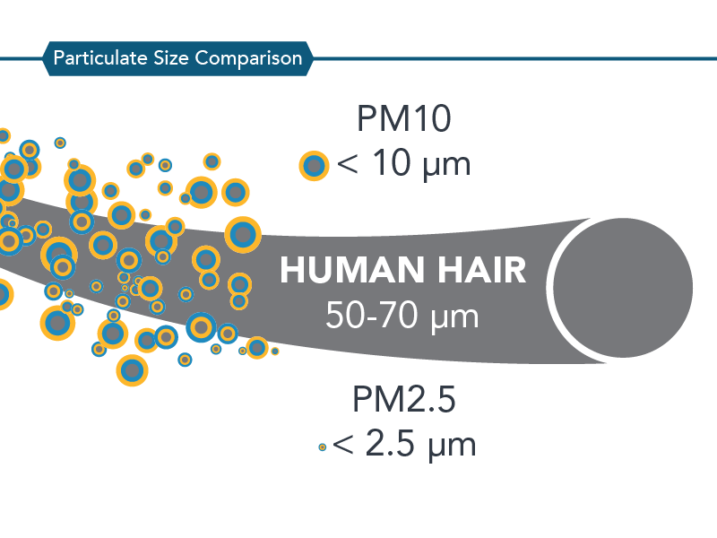
Other pollutants besides NO_{x} and O₃ can cause air-quality and health concerns.
Particulate Matter (PM)
PM2.5 – particulates with diameters 2.5 microns or less
reactions of gases produced by combustion produce solid aerosol particles
PM10 – particulates with diameters 10 microns or less
dusts, pollen, bacteria, products of burning, soot, tire fragments
Notes:
NO2 decreases because of presence of OH.
“Hydroxyl radicals are created in the atmosphere by two principal chemical reactions:
During daylight hours, a photochemical reaction occurs in the atmosphere where different wavelengths of light interact with water and terpenes (secreted from plants) in the air to produce simpler by-products known as Reactive Oxygen Species (ROS). One of the main types of ROS is the hydroxyl radical.
In addition, during the entire 24-hour cycle, OH is formed through the reaction between terpenes and ozone.”
https://en.wikipedia.org/wiki/Hydroxyl_radical

Slide 25
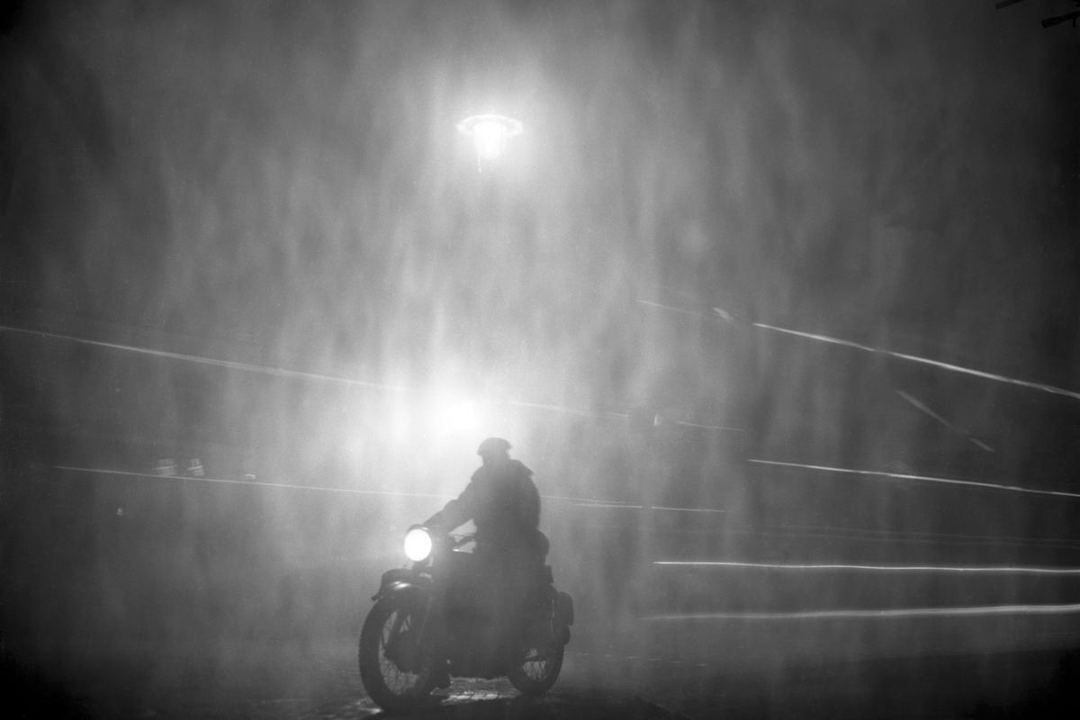
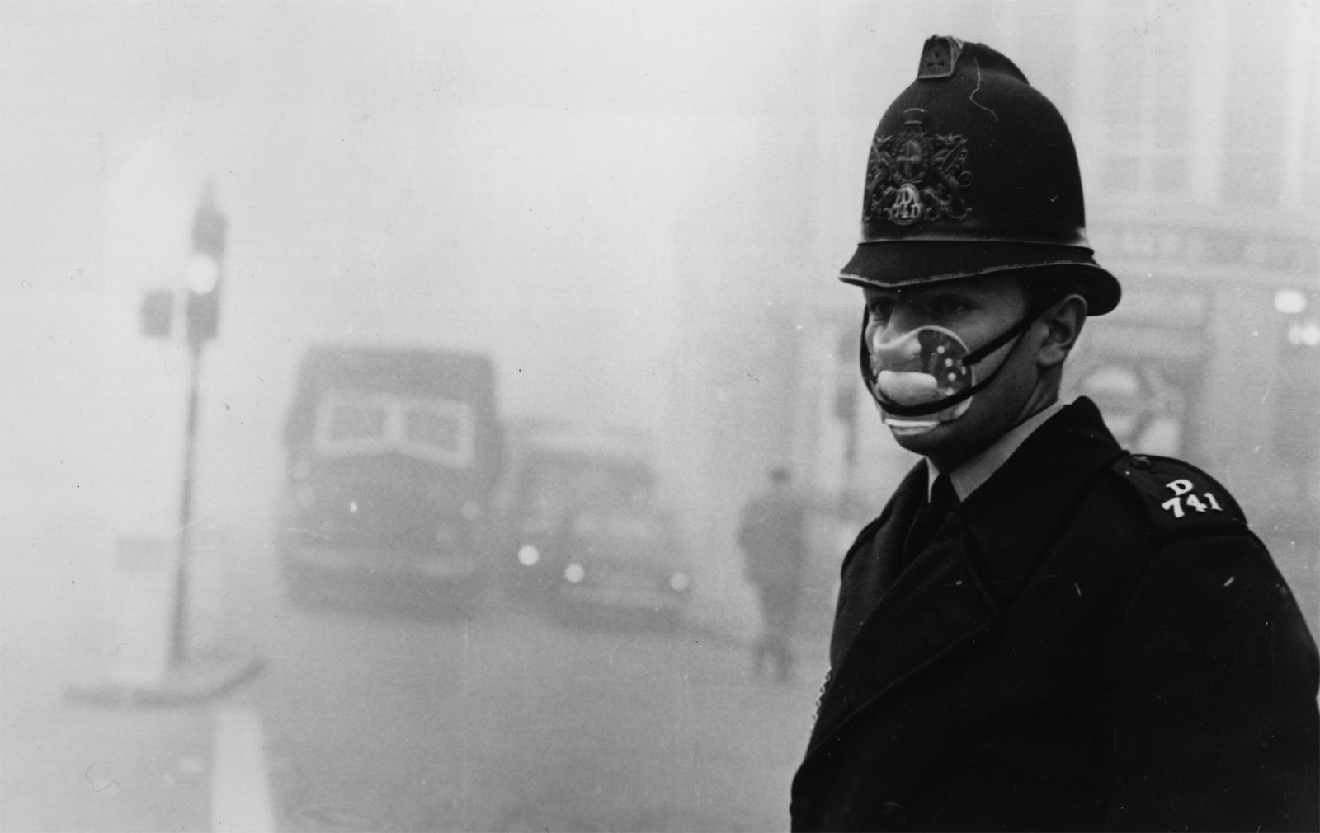
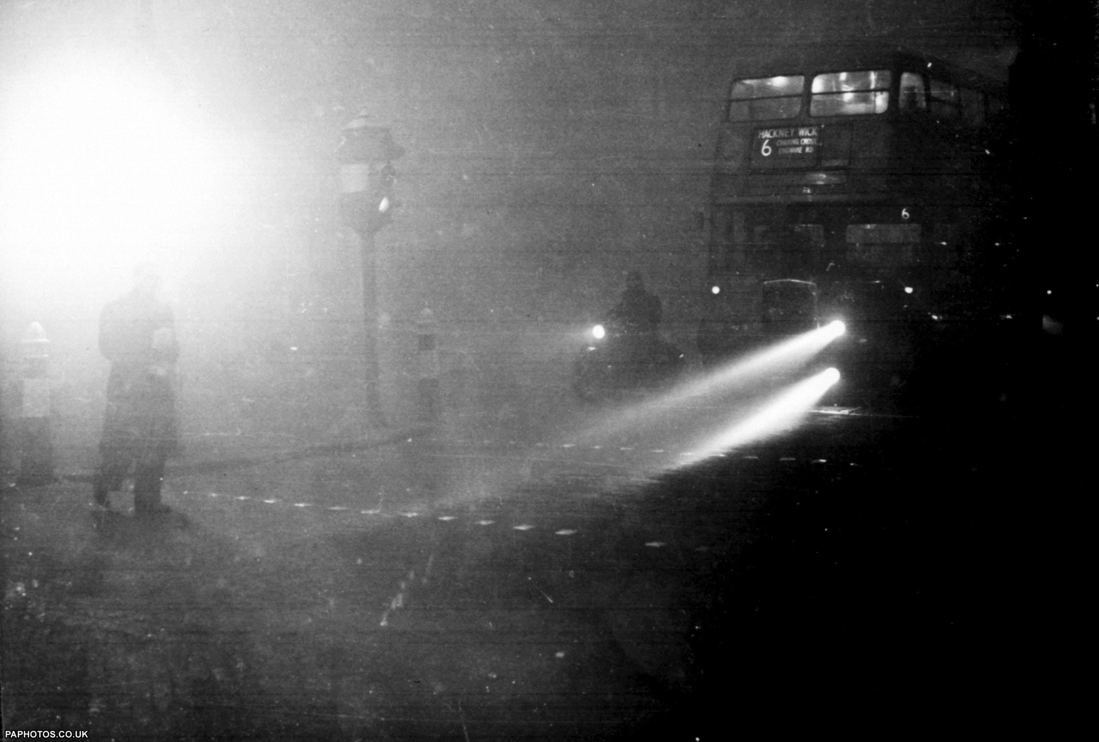
Great Smog of London: 5–9 December 1952
If high emissions are combined with a high-pressure system (sunny, weak winds, stable lower troposphere → inversion, hence poor vertical mixing), then a severe pollution episode can occur.
burning sulfur-rich coal
2 p.m.

Slide 26
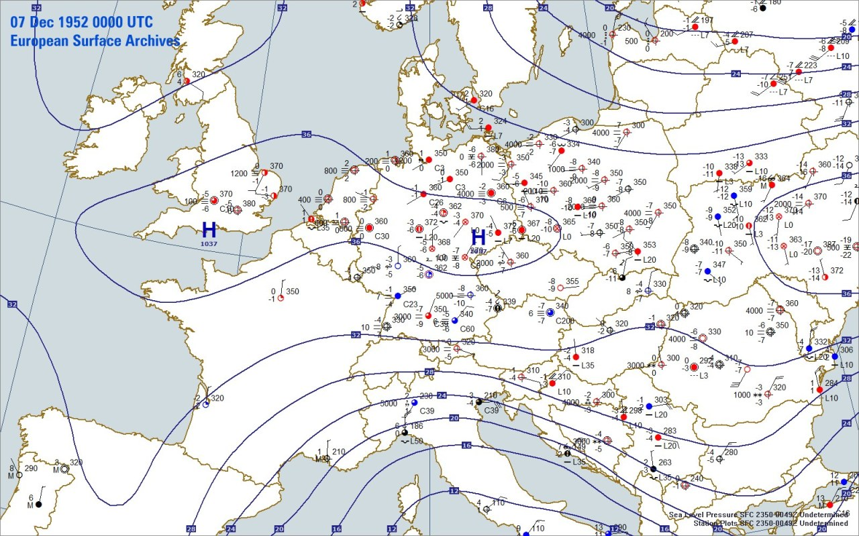
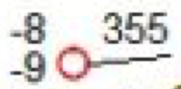
–5°C
T = –8°C
p = 1035.5
hPa
T_{d} = –9°C
Notes:
At 1.5 km above the surface, temperature was +2°C over London. –5°C to 0°C at the surface.

Slide 27
At about 1.5 km above the surface, temperature was +2°C over London
versus –5°C to 0°C at the surface.
When temperature increases with height, we call it an inversion.
Inversions inhibit vertical mixing, trapping pollutants, and causing
poor air quality.
Notes:
At 1.5 km above the surface, temperature was +2°C over London. –5°C to 0°C at the surface.

Slide 28
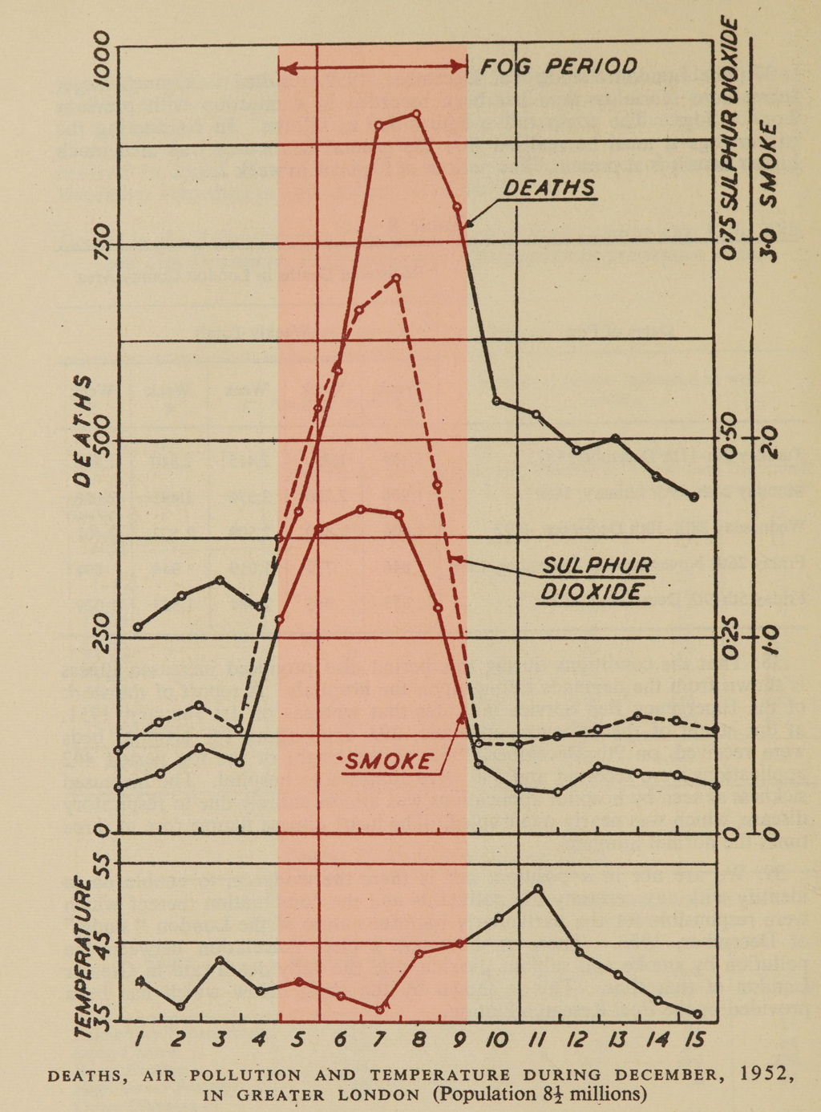
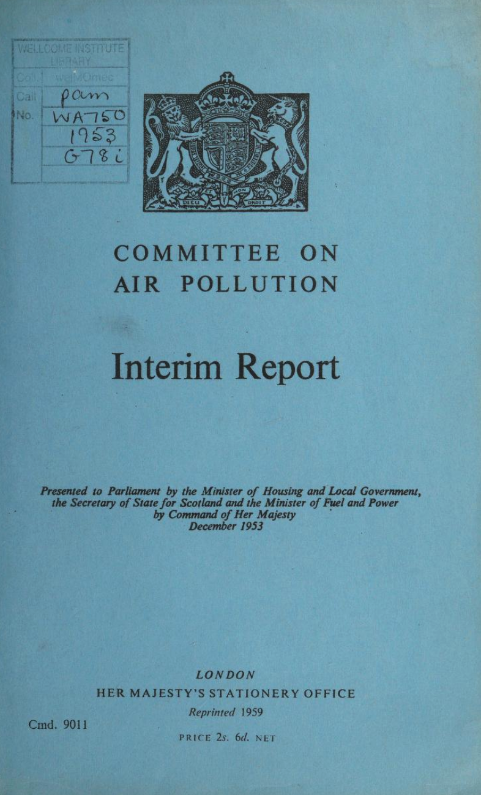
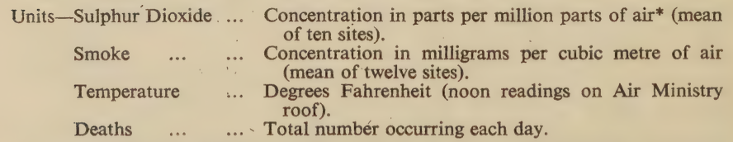
https://archive.org/details/b32170129/
Notes:
Source: Beaver, Hugh (December 1953). "Great Britain Committee on Air Pollution: Interim Report". London: HMSO. pp. 17–18. Retrieved 6 April 2023.
https://archive.org/details/b32170129/
Units—Sulphur Dioxide. . Concentration in parts per million parts of air* (mean of ten sites).
Smoke ae . Concentration in milligrams per cubic metre of air eo a (mean of twelve sites).
Temperature beses Fahrenheit(noonreadingsonAirMinistry roof). .
Deaths ee ...» Total numbér occurring each day.
More on the Great Smog: https://blog.nationalarchives.gov.uk/the-great-smog-of-1952/

Slide 29
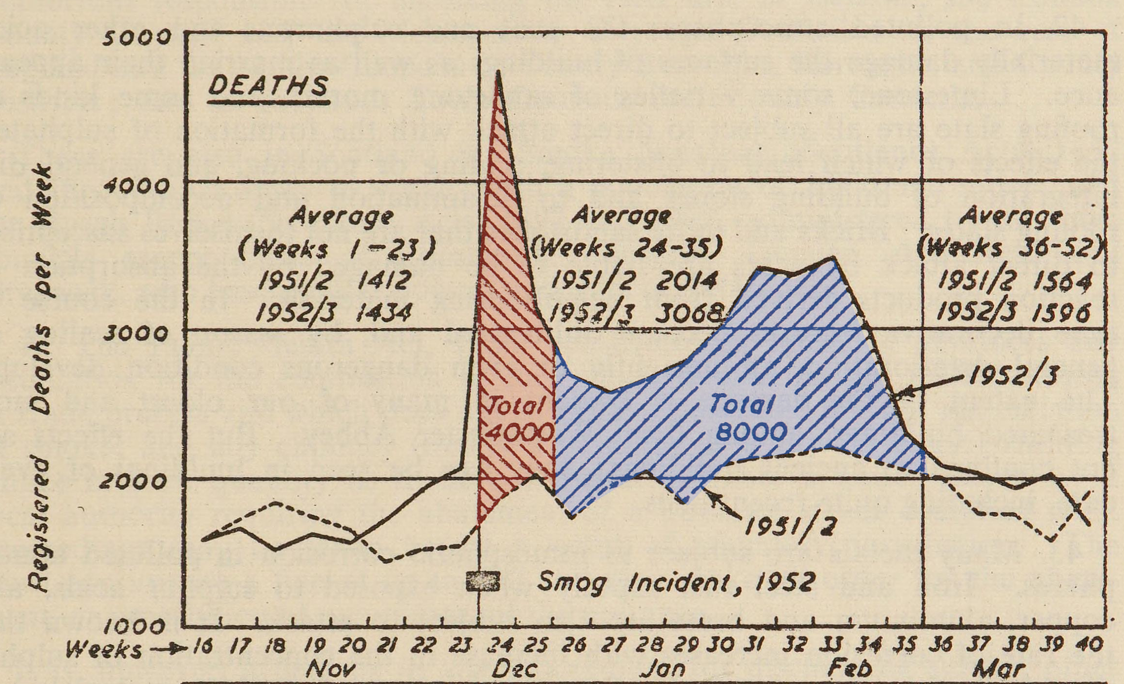
Excess deaths is commonly
used in epidemiology.
Notes:
Source: Beaver, Hugh (December 1953). "Great Britain Committee on Air Pollution: Interim Report". London: HMSO. pp. 17–18. Retrieved 6 April 2023.
https://archive.org/details/b32170129/
More on the Great Smog: https://blog.nationalarchives.gov.uk/the-great-smog-of-1952/

Slide 30
How to use ManUniCast to look at
tropospheric chemistry
http://www.manunicast.com

Slide 31



ManUniCast.com

Slide 32
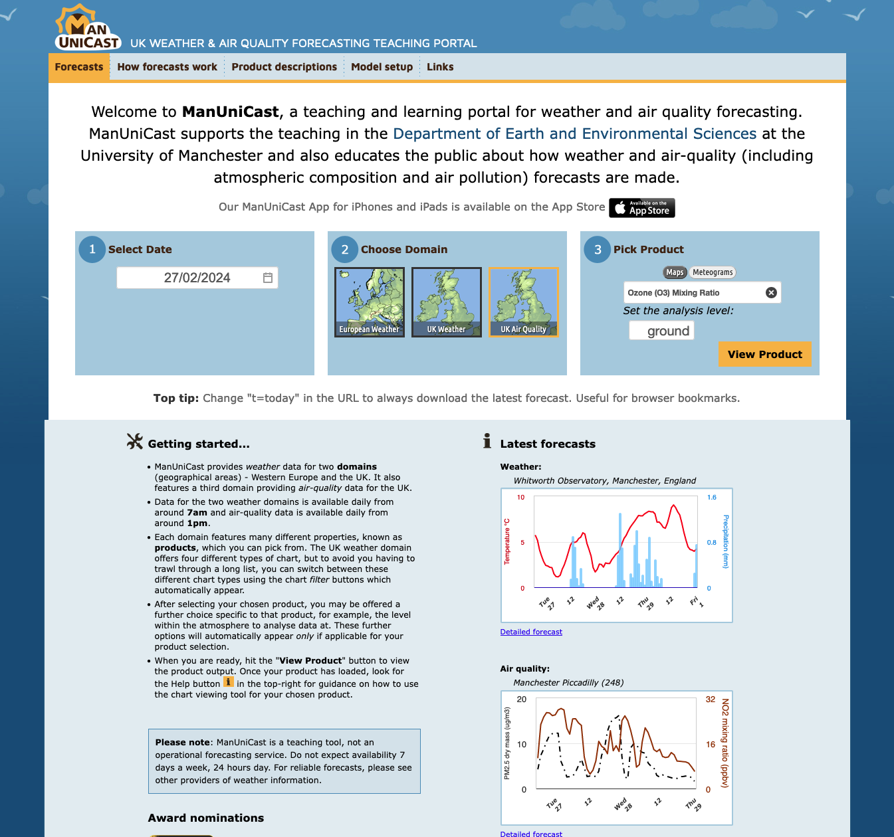
ManUniCast.com

Slide 33
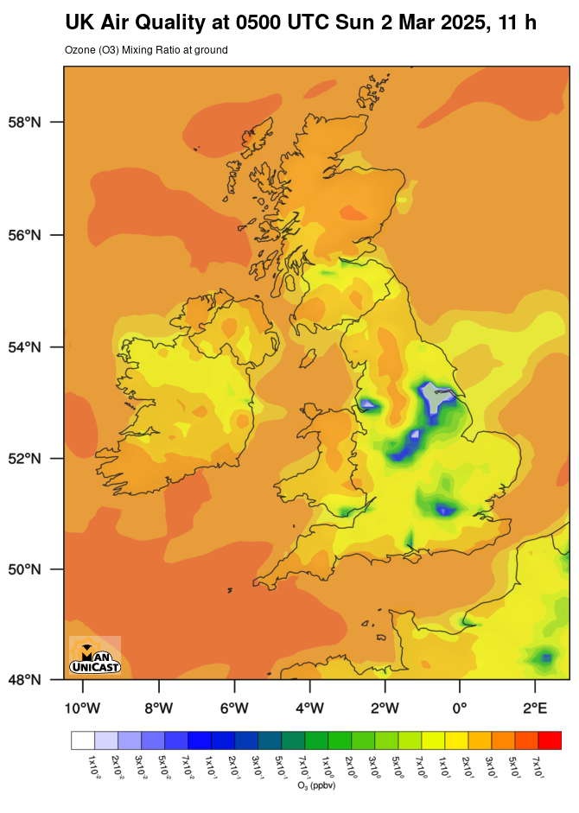
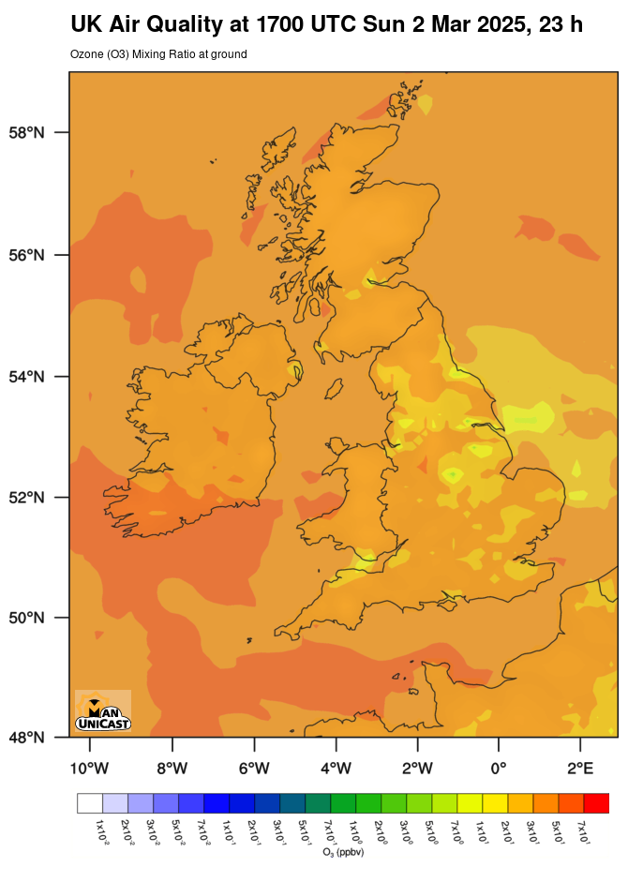
5 a.m.
5 p.m.
ozone
Notes:
https://manunicast.seaes.manchester.ac.uk/view.php?t=20250302&d=d03&p=138&l=0

Slide 34
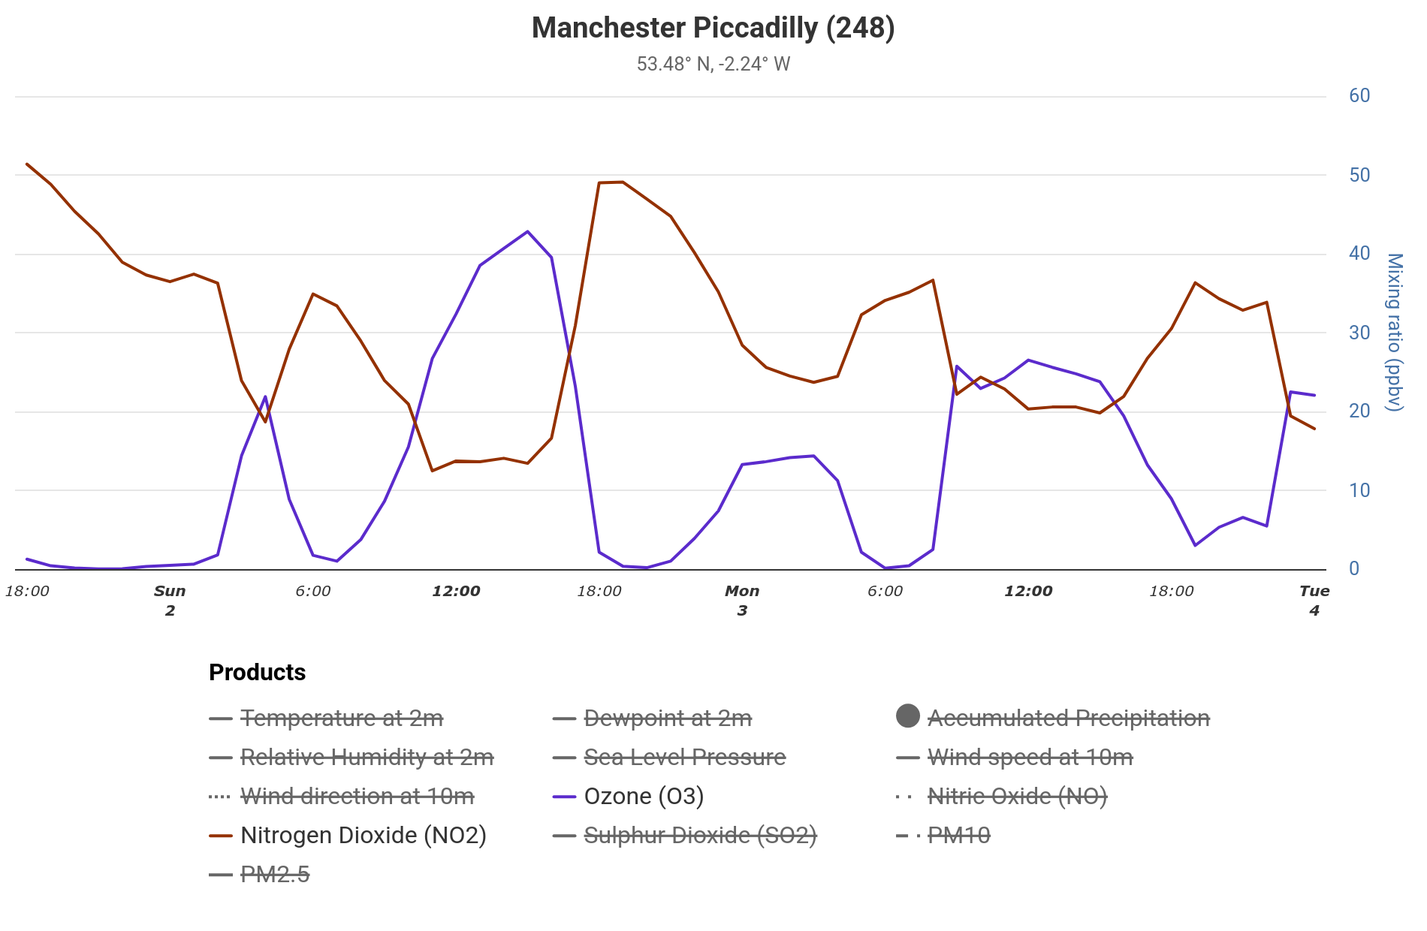
NO₂
ozone
Notes:
https://manunicast.seaes.manchester.ac.uk/view.php?t=20250302&d=d03&p=185&l=0

Slide 35
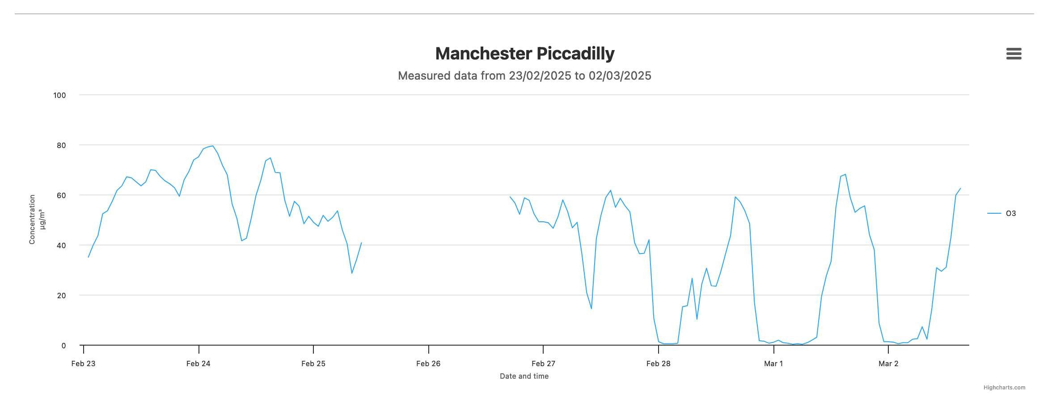
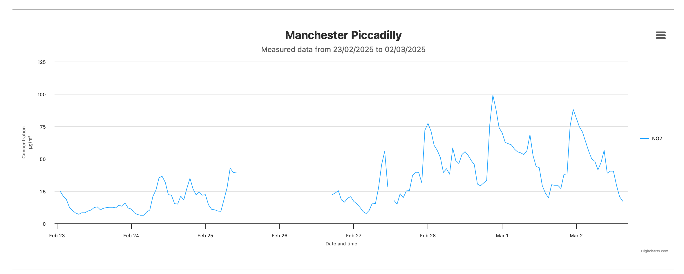
observations
ozone
NO₂
Thurs
Fri
Sun
Sun
Notes:
https://uk-air.defra.gov.uk/latest/period_plots?POL=O3&days=7
https://uk-air.defra.gov.uk/latest/period_plots?POL=NO2&days=7

Slide 36
Hydrosphere

Slide 37
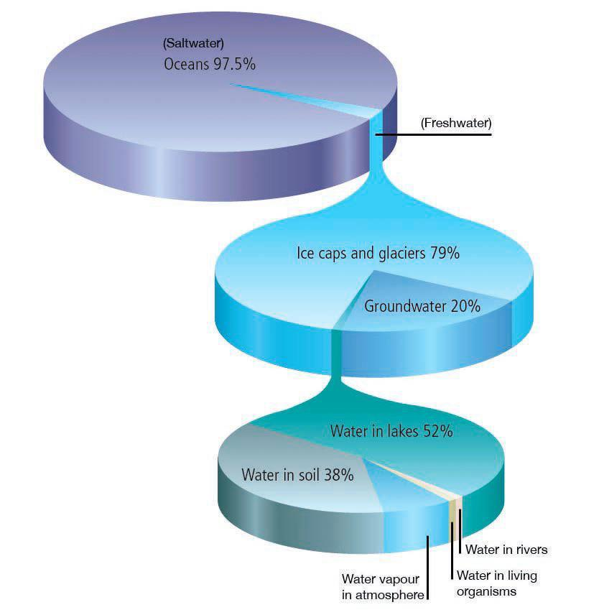
Water on Earth
is mostly in the
oceans.
Atmospheric water is
generally not considered
part of the hydrosphere.

Slide 38
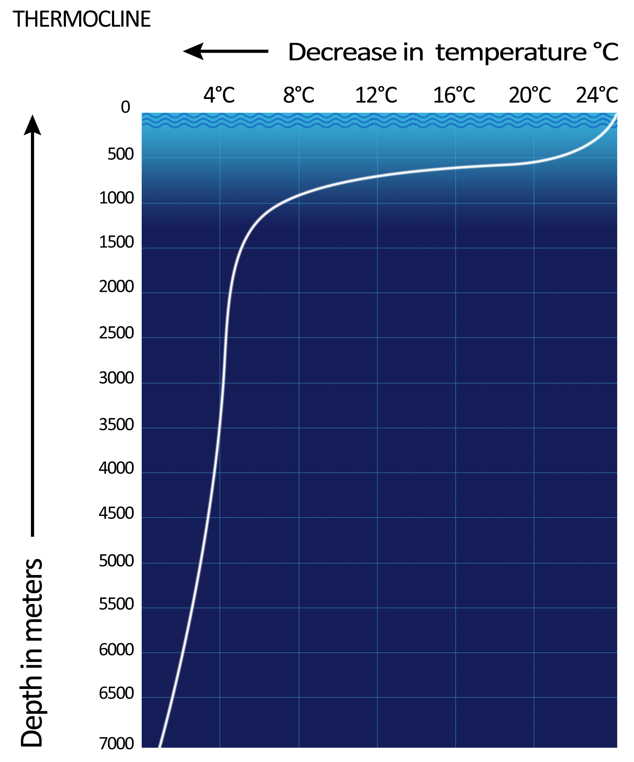
Today’s oceans are deeply stratified (has not always been the case).
The thermocline inhibits mixing and is strongest in summer.
Schematic tropical ocean
thermocline
(depth vs. temperature).
Wikipedia
Notes:
For a real-time example of this, see the Tropical Atmosphere Ocean observing array in the tropical North Pacific Ocean. Here is one of those sites with temperature as a function of depth.
https://tao.ndbc.noaa.gov/refreshed/site.php?site=24
For a real-time look at buoys around the world, see https://www.ndbc.noaa.gov/.

Slide 39
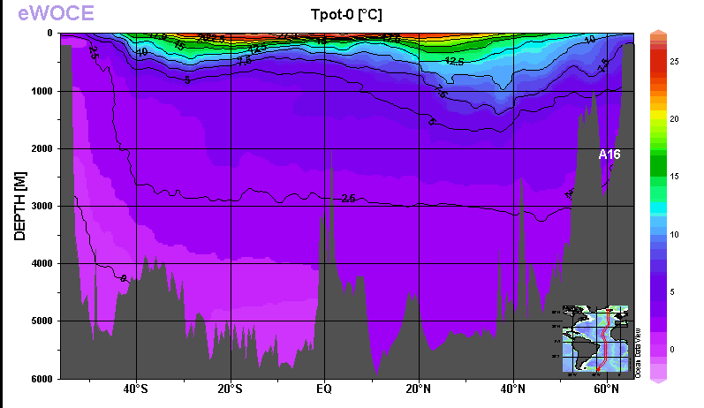
Vertical meridional section of potential temperature in the Atlantic Ocean
The thermocline is the region of large dT/dz close to the surface.
Only a tiny fraction of the ocean interacts with the atmosphere directly.
The Ocean is heated from above and so becomes stably stratified, inhibiting heat transfer to lower levels

Slide 40
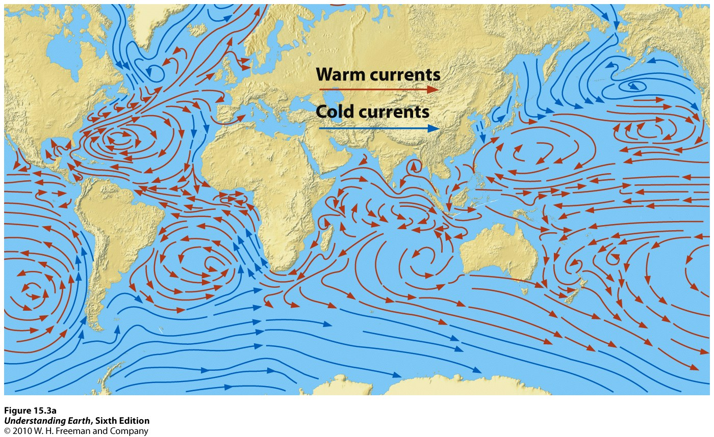
Surface Ocean Currents

Slide 41
Surface Ocean Currents
western boundary current
equatorial currents
Gulf Stream
Kuroshio Current
clockwise
gyres in Northern
Hemisphere in each
ocean basin
equatorial currents
Ocean currents
transport warm water
poleward and cold water
equatorward.
counterclockwise
gyres in Southern
Hemisphere in each
ocean basin
Notes:
kùróshíó

Slide 42
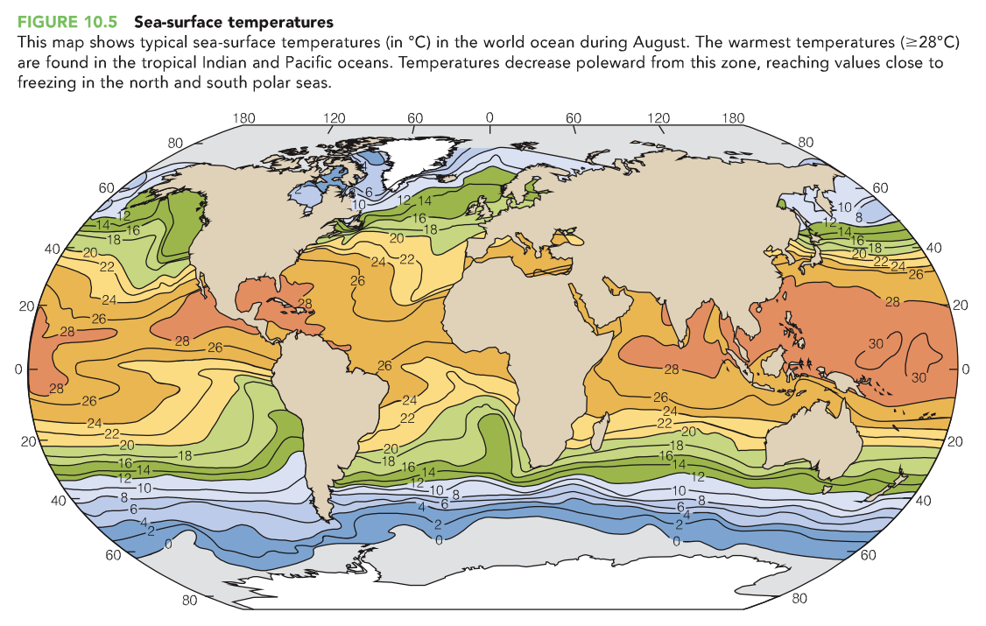
Figure source: Skinner and Murck: The Blue Planet: An Introduction to Earth System Science, 3rd Edition.
Notes:
42
S

Slide 43
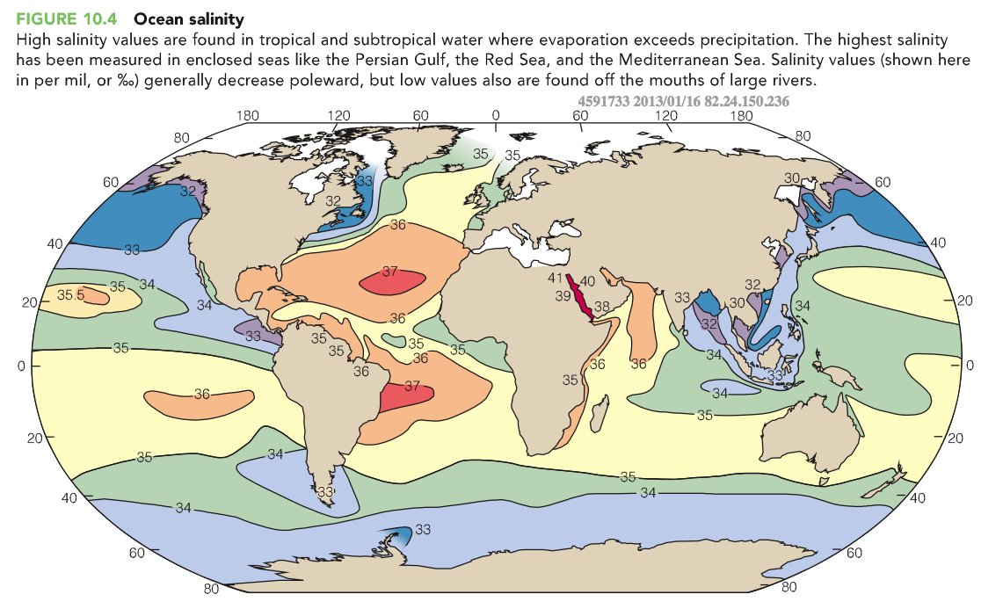
Figure source: Skinner and Murck: The Blue Planet: An Introduction to Earth System Science, 3rd Edition.
Notes:
43
S

Slide 44
E is evaporation; P is precipitation (and runoff)
P>E
P>E
E>P
P>E
E>P
P>E
Figure source: Skinner and Murck: The Blue Planet: An Introduction to Earth System Science, 3rd Edition.
Notes:
44
S

Slide 45
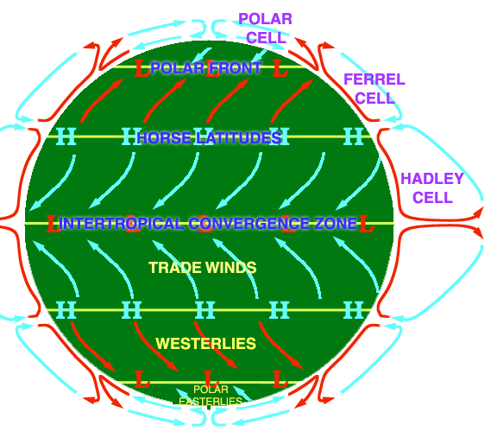
E is evaporation; P is precipitation (and runoff)
Polar Jet Stream
P>E
P>E
E>P
P>E
E>P
Polar Jet Stream
P>E
Figure source: Skinner and Murck: The Blue Planet: An Introduction to Earth System Science, 3rd Edition.
Notes:
45
S

Slide 46
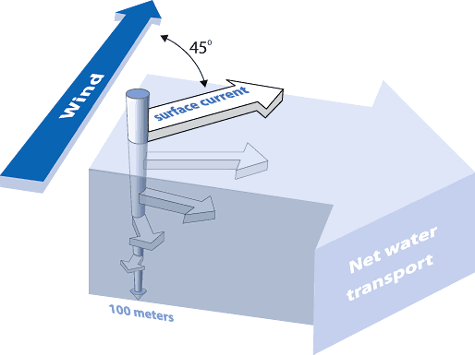
Friction and the Coriolis force both lead to the current being at a right angle to the wind.
To the right of the wind in the NH; left of the wind in the SH.
Ekman spiral
Northern Hemisphere (NH)
NOAA Ocean Service
Notes:
46
http://oceanservice.noaa.gov/education/kits/currents/media/supp_cur05e.html
The Ekman spiral, named after Swedish scientist Vagn Walfrid Ekman (1874-1954) who first theorized it in 1902, is a consequence of the Coriolis effect. When surface water molecules move by the force of the wind, they, in turn, drag deeper layers of water molecules below them. Each layer of water molecules is moved by friction from the shallower layer, and each deeper layer moves more slowly than the layer above it, until the movement ceases at a depth of about 100 meters (330 feet). Like the surface water, however, the deeper water is deflected by the Coriolis effect—to the right in the Northern Hemisphere and to the left in the Southern Hemisphere. As a result, each successively deeper layer of water moves more slowly to the right or left, creating a spiral effect. Because the deeper layers of water move more slowly than the shallower layers, they tend to “twist around” and flow opposite to the surface current.

Slide 47
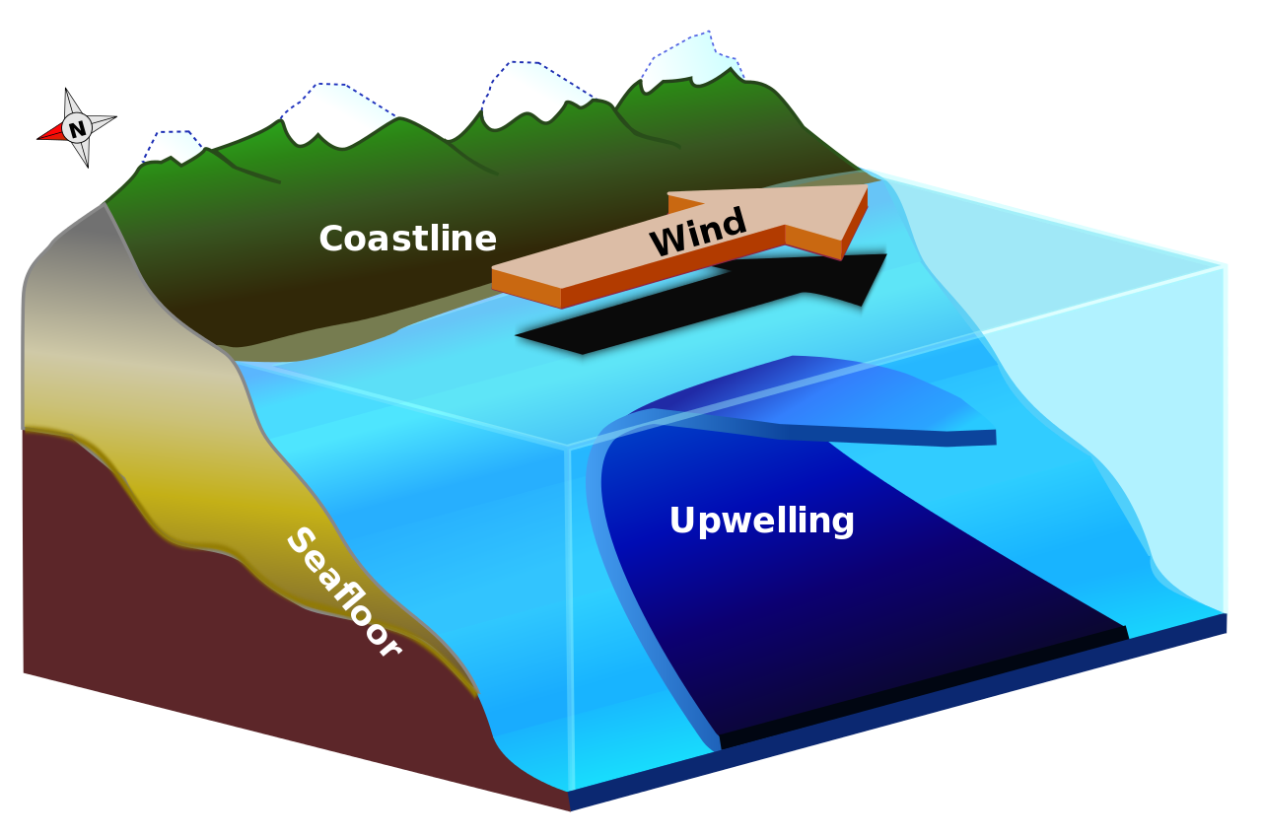
Upwelling
Northern Hemisphere
(Lichtspiel)

Slide 48
Upwelling
Ekman transport
cool, nutrient-rich
water
(Lichtspiel)

Slide 49
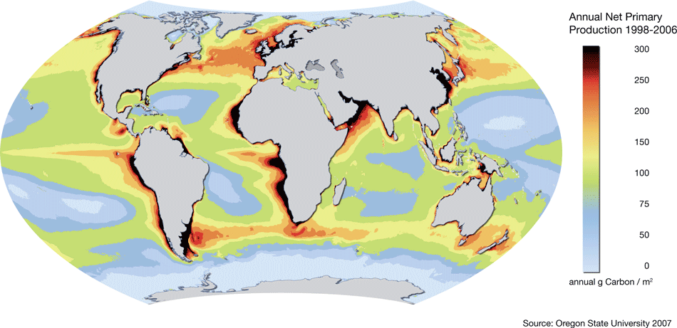
Life is not uniformly distributed in the oceans.
Ekman transport
cool, nutrient-rich
water
rate at which plants produce net useful chemical energy (g of C m^{–2})
(nordpil.com)

Slide 50
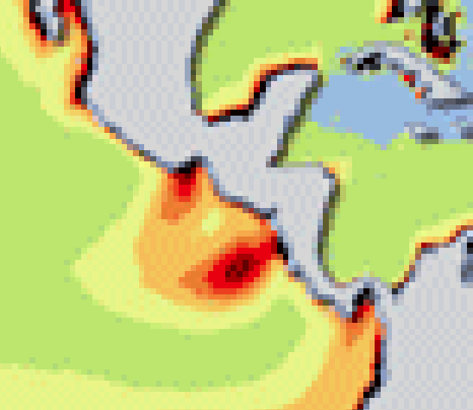
Annual Net Primary Production
Ekman transport
cool, nutrient-rich
water
(nordpil.com)

Slide 51
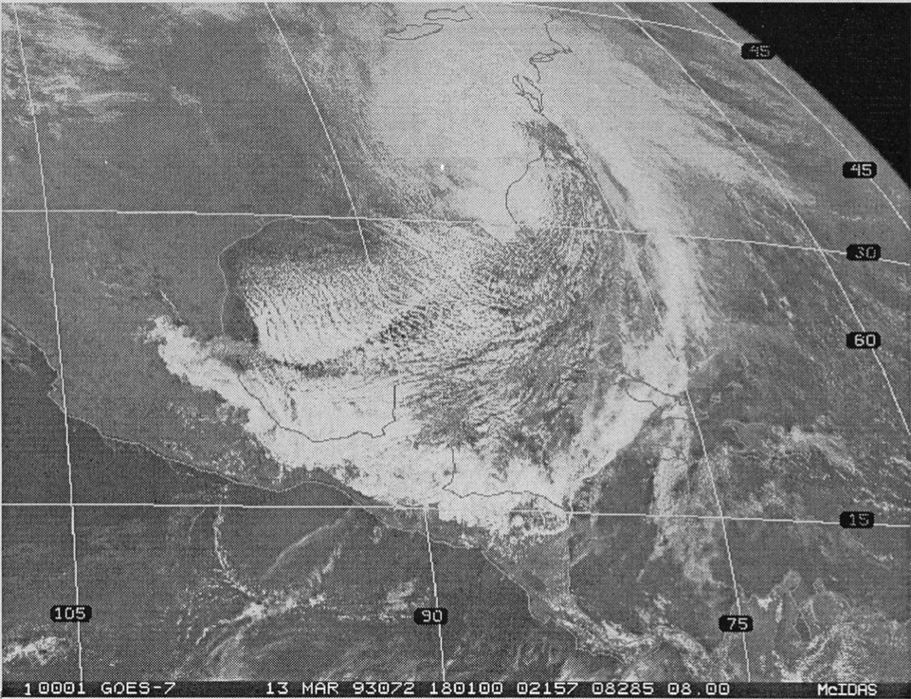
(Schultz et al. 1997, Mon. Wea. Rev.)
Visible satellite imagery of:
Tropical or extratropical cyclone?
Where’s the low center?
Notes:
Schultz, D. M., W. E. Bracken, L. F. Bosart, G. J. Hakim, M. A. Bedrick, M. J. Dickinson, and K. R. Tyle, 1997: The 1993 Superstorm cold surge: Frontal structure, gap flow, and tropical impact. Mon. Wea. Rev., 125, 5–39; Corrigendum, 125, 662.

Slide 52
(Schultz et al. 1997, Mon. Wea. Rev.)
L
Notes:
Schultz, D. M., W. E. Bracken, L. F. Bosart, G. J. Hakim, M. A. Bedrick, M. J. Dickinson, and K. R. Tyle, 1997: The 1993 Superstorm cold surge: Frontal structure, gap flow, and tropical impact. Mon. Wea. Rev., 125, 5–39; Corrigendum, 125, 662.

Slide 53
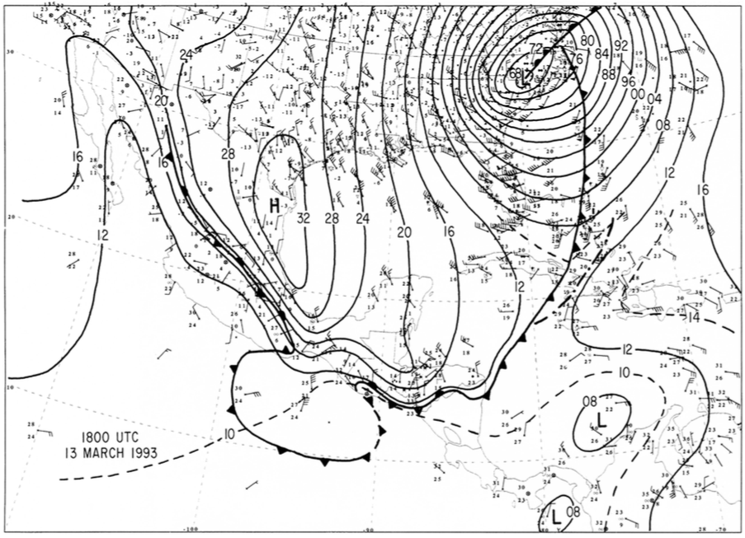
(Schultz et al. 1997, Mon. Wea. Rev.)
(Schultz et al. 1997, Mon. Wea. Rev.)
Sea-level pressure and winds
Notes:
Schultz, D. M., W. E. Bracken, L. F. Bosart, G. J. Hakim, M. A. Bedrick, M. J. Dickinson, and K. R. Tyle, 1997: The 1993 Superstorm cold surge: Frontal structure, gap flow, and tropical impact. Mon. Wea. Rev., 125, 5–39; Corrigendum, 125, 662.

Slide 54
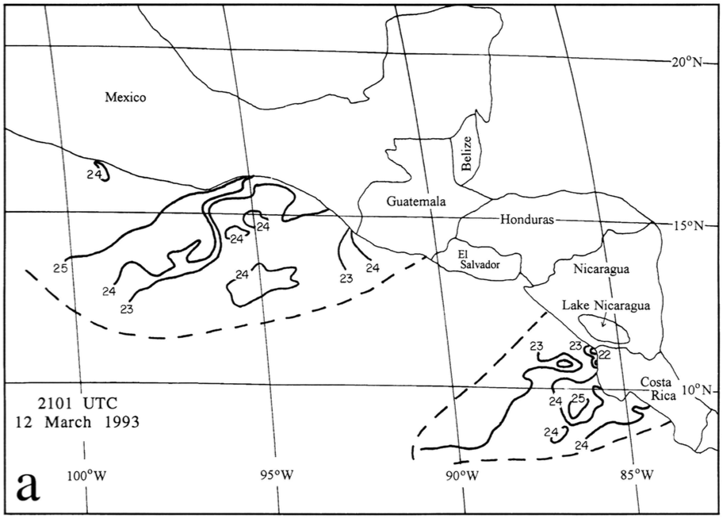
(Schultz et al. 1997, Mon. Wea. Rev.)
Sea-Surface Temperature from Satellite (°C)
Notes:
Schultz, D. M., W. E. Bracken, L. F. Bosart, G. J. Hakim, M. A. Bedrick, M. J. Dickinson, and K. R. Tyle, 1997: The 1993 Superstorm cold surge: Frontal structure, gap flow, and tropical impact. Mon. Wea. Rev., 125, 5–39; Corrigendum, 125, 662.

Slide 55
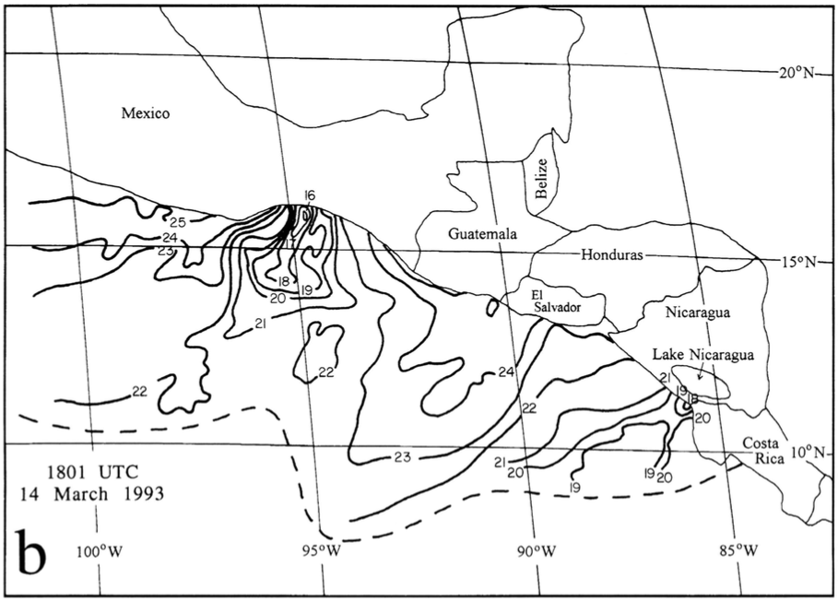
(Schultz et al. 1997, Mon. Wea. Rev.)
Sea-Surface Temperature from Satellite (°C)
Notes:
Schultz, D. M., W. E. Bracken, L. F. Bosart, G. J. Hakim, M. A. Bedrick, M. J. Dickinson, and K. R. Tyle, 1997: The 1993 Superstorm cold surge: Frontal structure, gap flow, and tropical impact. Mon. Wea. Rev., 125, 5–39; Corrigendum, 125, 662.

Slide 56
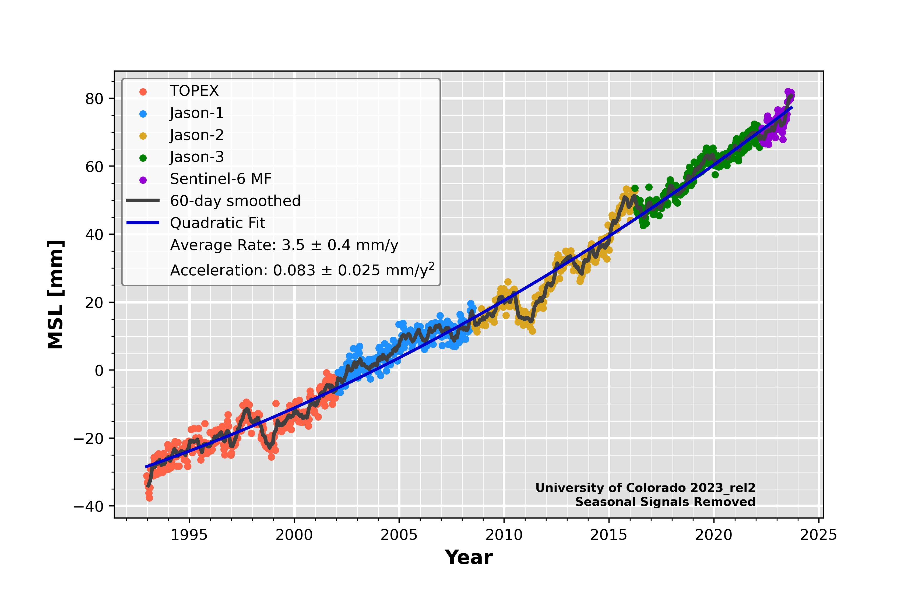
Mean sea level is rising as the oceans warm
(expand and occupy more volume).
https://sealevel.colorado.edu/
Notes:
https://sealevel.colorado.edu/

Slide 57
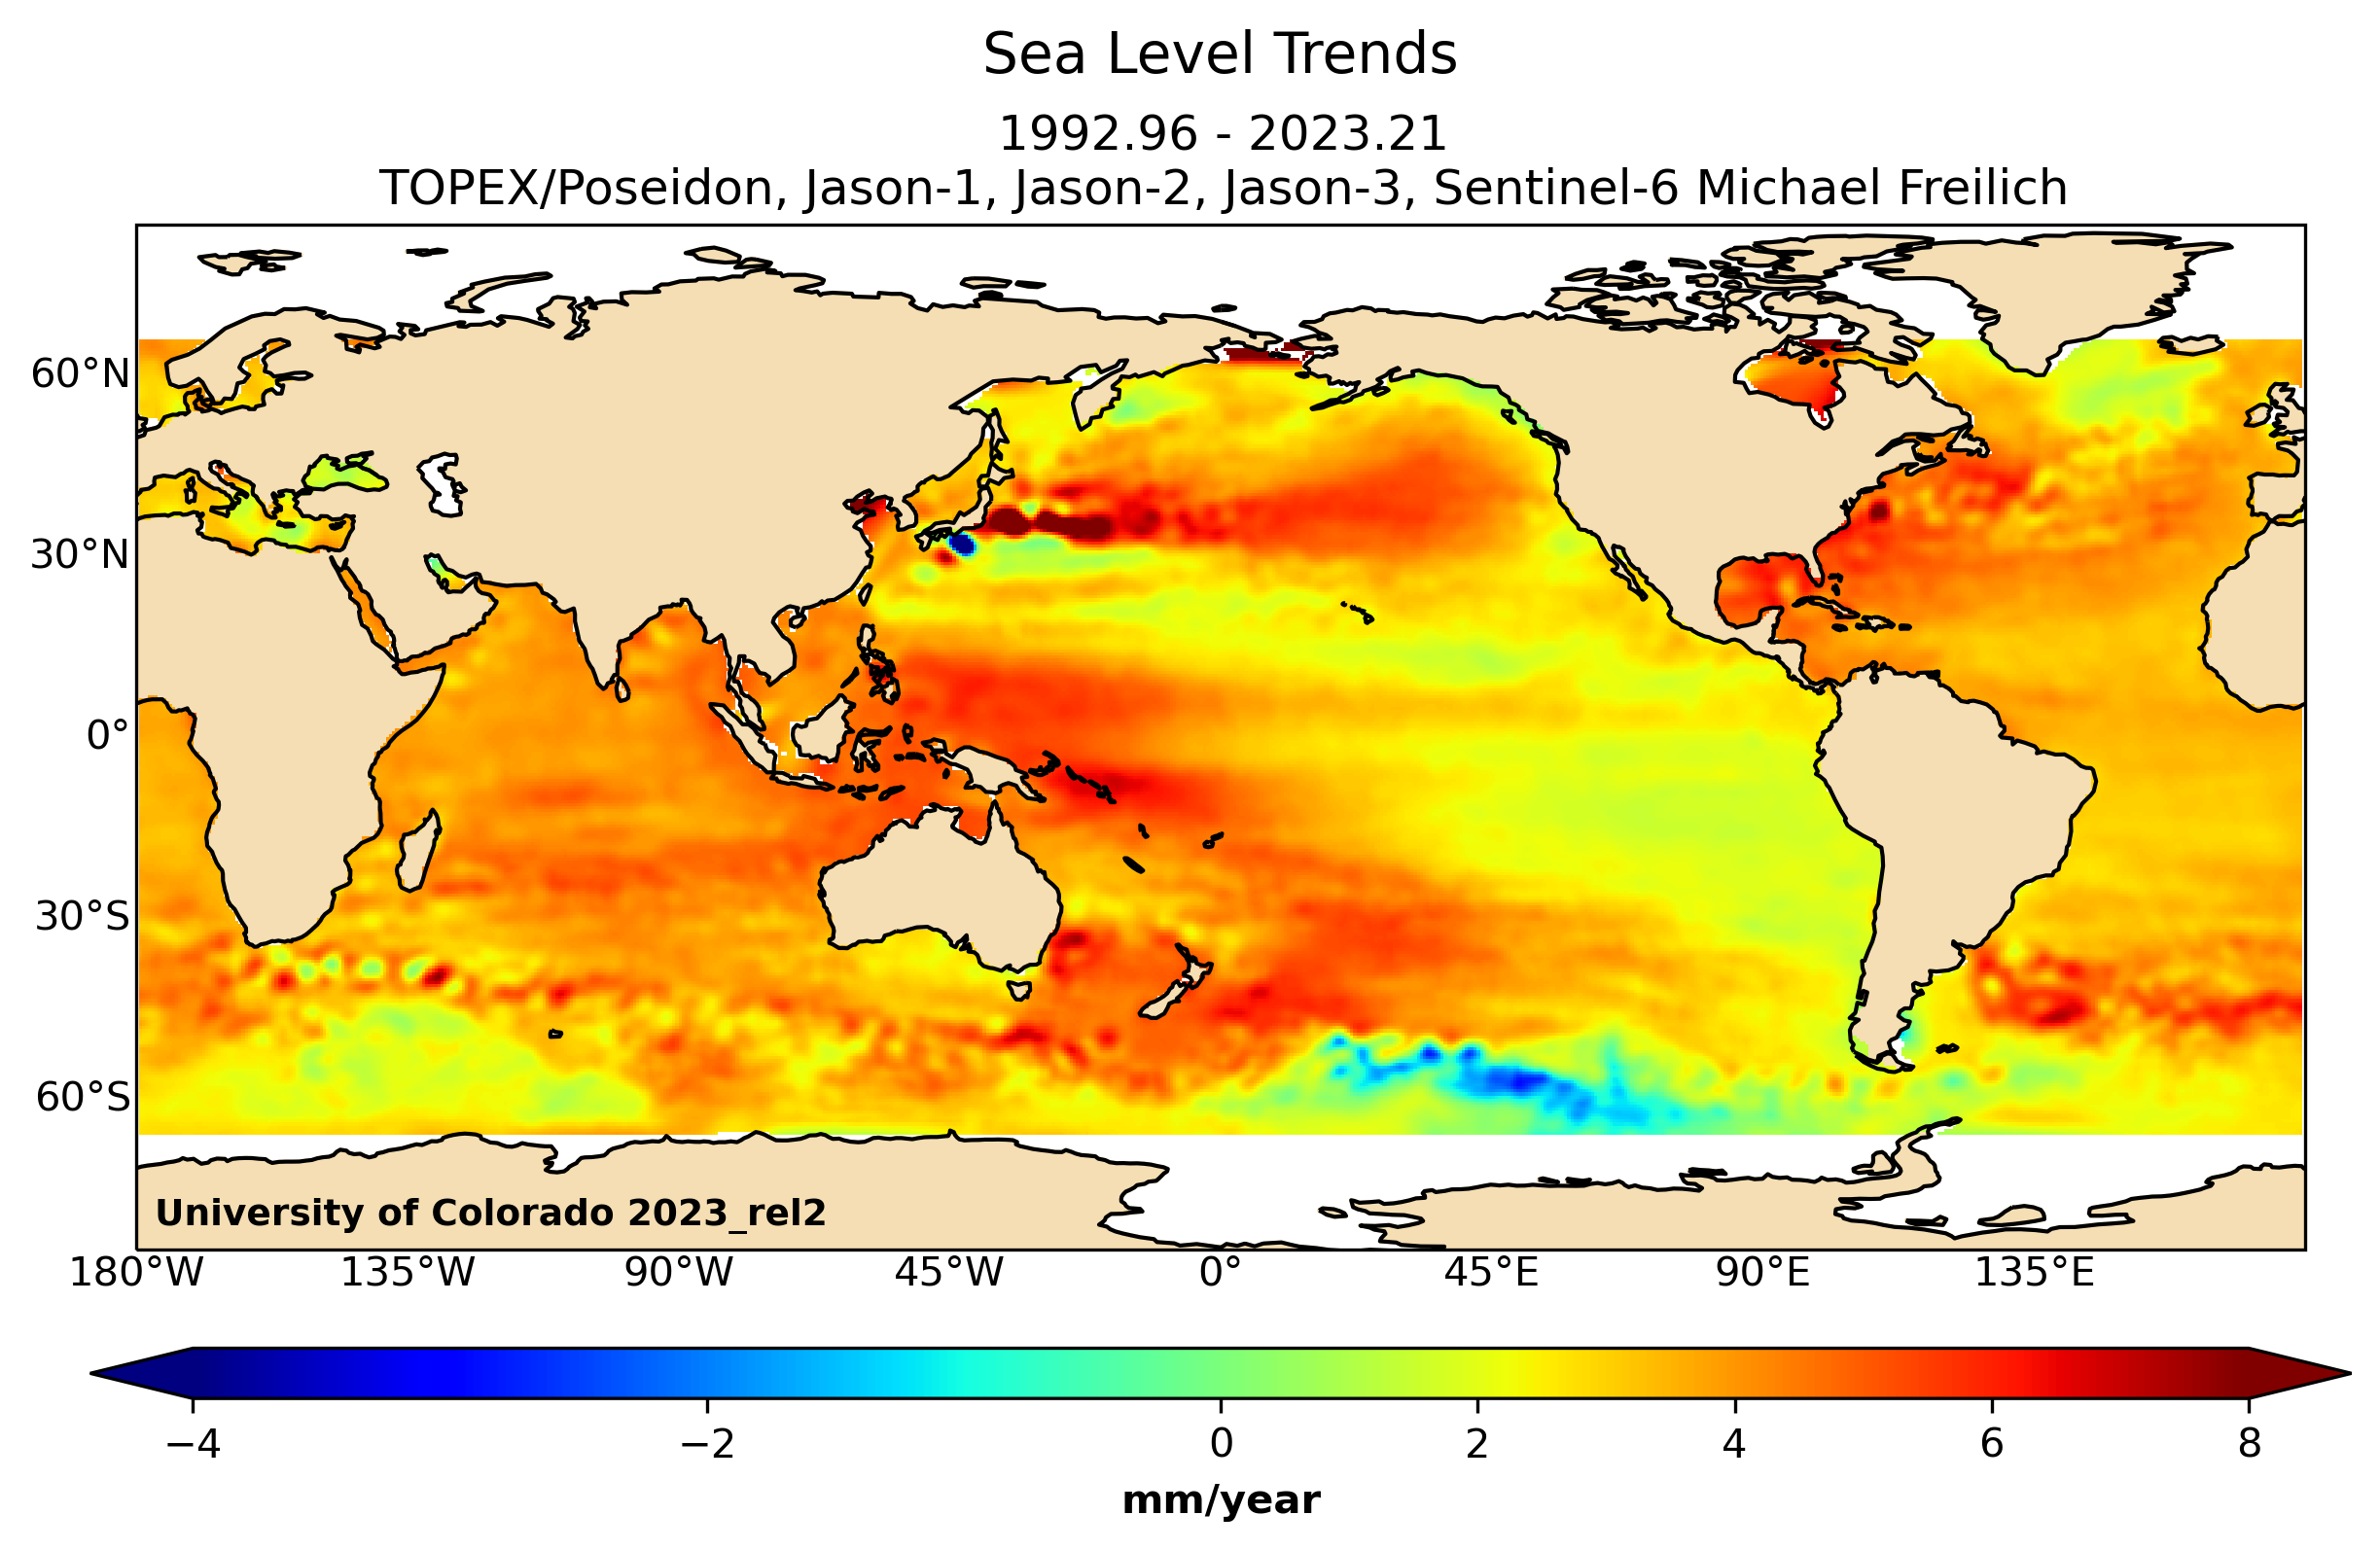
Mean sea level is rising as the oceans warm
(expand and occupy more volume).
https://sealevel.colorado.edu/trend-map
Notes:
https://sealevel.colorado.edu/

Slide 58
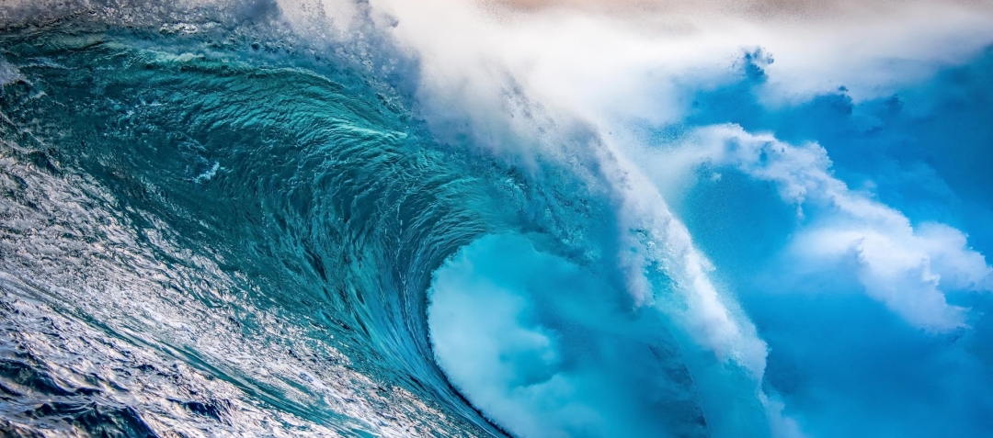
Waves

Slide 59
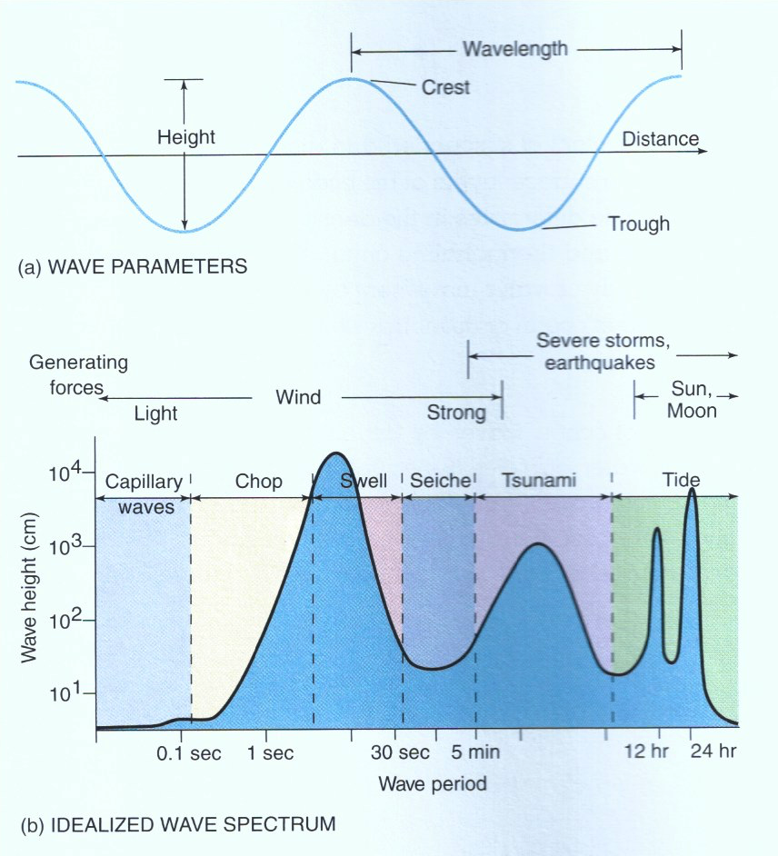
definitions
causes of waves
definitions of waves
wave period vs
log(wave height)
(Pinet 2016, Invitation to Oceanography)

Slide 60
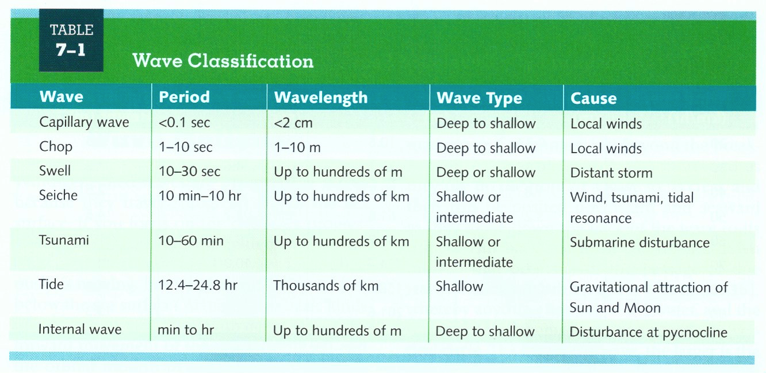
(Pinet 2016, Invitation to Oceanography)

Slide 61
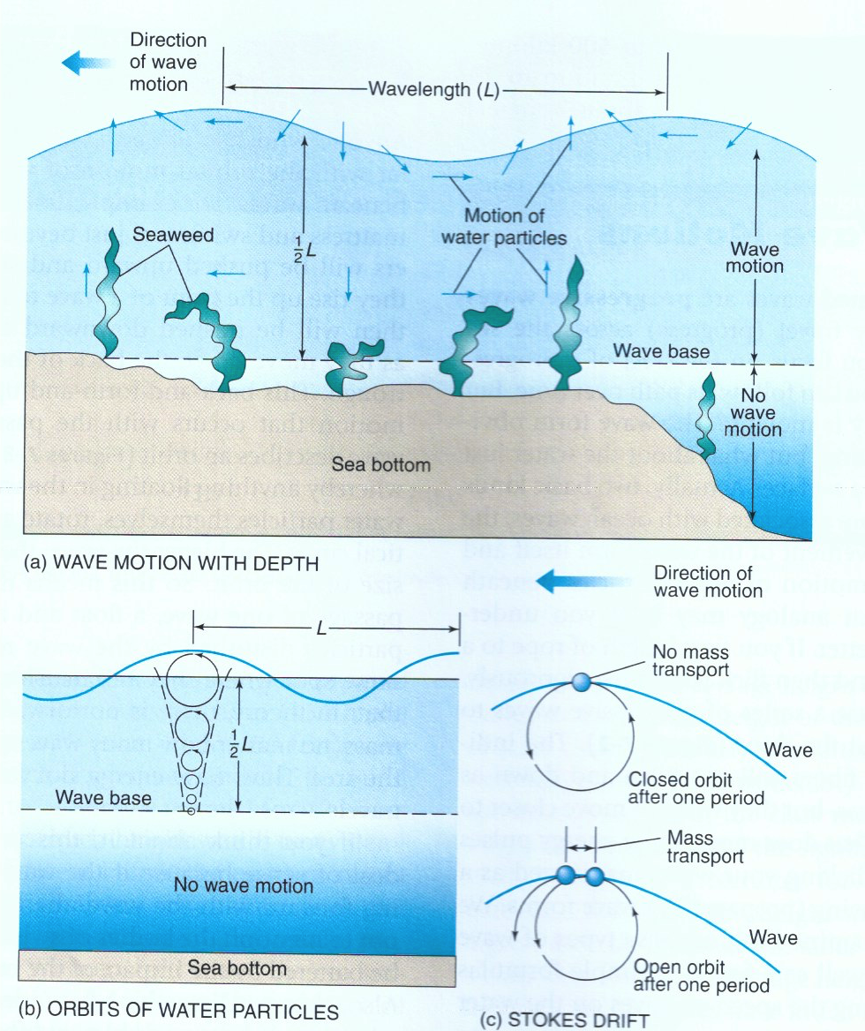
Surface waves mostly* do not
transport water molecules
forward.
definitions of wave base
*except for Stokes drift
(Pinet 2016, Invitation to Oceanography)

Slide 62
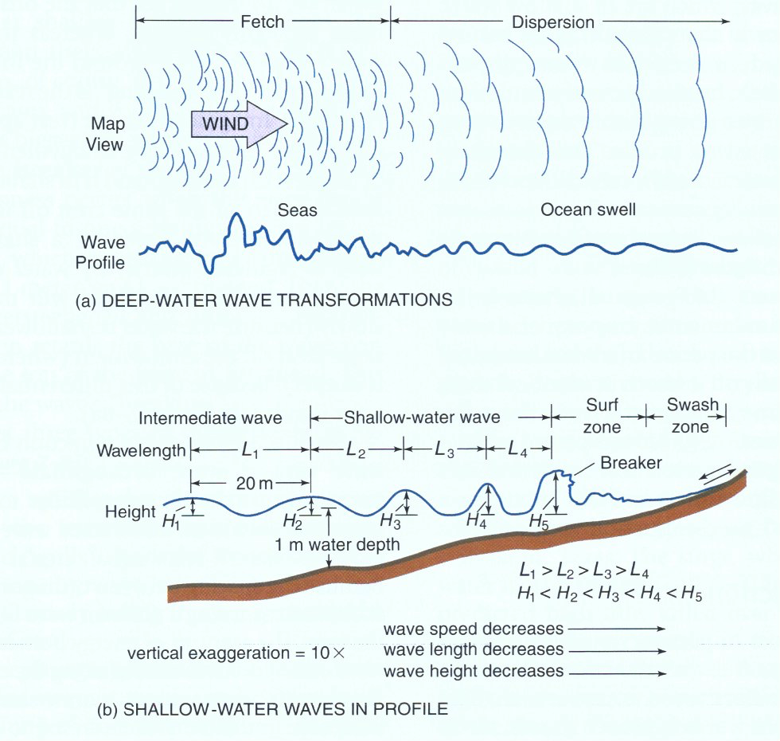
(Pinet 2016, Invitation to Oceanography)
Notes:
Irregular waves in the fetch area because of constructive and destructive interferences. Outside the fetch, a regular ocean swell develops as the waves sort themselves according to the speed by dispersion. Shorter period waves travel slower than longer period waves.

Slide 63
deep-water waves
increases
(Pinet 2016, Invitation to Oceanography)
Notes:
Error: “wave height decreases” in original figure should be “wave height increases” (as corrected on slide)

Slide 64

Waves entering shallow water refract, approaching the shoreline in a more parallel orientation.

Slide 66

(Pinet 2016, Invitation to Oceanography)

Slide 67

https://www.ready.gov/tsunamis
https://community.fema.gov/ProtectiveActions/s/article/Tsunami

Slide 68

Tides

Slide 69

(Pinet 2016, Invitation to Oceanography)

Slide 70


Slide 71

(Pinet 2016, Invitation to Oceanography)

Slide 72

(Pinet 2016, Invitation to Oceanography)

Slide 73

(½ day)
(1 day)
(13.6 days)
(27.4 days)
(182.6 days)
(Pond and Pickard 1983, Introductory Dynamical Oceanography)

Slide 74

https://moon.nasa.gov/moon-in-motion/tides/

Slide 75



https://ntslf.org/tides/predictions
Notes:
https://ntslf.org/about-tides/tides-faq

Slide 76


https://www.surfline.com
Notes:
https://www.surfline.com

Slide 77

https://www.surf-forecast.com/weather_maps/United-Kingdom?over=none&type=htsgw
Notes:
https://ntslf.org/about-tides/tides-faq

Slide 78


The atmosphere has tides, too although relatively small and generated by heating rather than gravitational tidal forces.
Day 0.5 1 1.5 2 2.5 3
Atmospheric pressure at Ascension Island (8°S in the Atlantic)
Amplitude of the S₂ (principal solar semidiurnal) atmospheric tide at the surface. 1000 = 1 mbar
Phase of the S₂ atmospheric tide at the surface. Propagation is to the west
(Courtesy of Chris Hughes, Univ of Liverpool)

Slide 79


The atmospheric tide varies across the globe.
average tides
(Mass, Steenburgh, and Schultz 1991, Monthly Weather Review)

Slide 80
For Week 8 (17 March ☘️)...
Required Videos to Watch:
The Cryosphere: The Rise and Fall of Ice on Earth
Arctic Climate Change
BYOE Video 1: Introduction
BYOE Video 2: Walkthrough 1
BYOE Video 1: Walkthrough 2
BYOE Video 1: Earth’s Past Climates
Required Reading:
Lear et al. (2020): “What the geological record tells us about our present and future climate”

Slide 81
Reading Around the Topic
How Do Climate Models Work? (CarbonBrief.org)

Slide 82
On your computer’s or phone’s web browser, go to
kahoot.it
You can download the kahoot app or bookmark the website for future lectures.

Slide 83
Attendance
645284

